Slide 1


Operation of Unmanned
Aircraft System
Module 1│Module 2│Module 3

Slide 2

010 00 00: General UAS Knowledge
Module 1

Slide 3

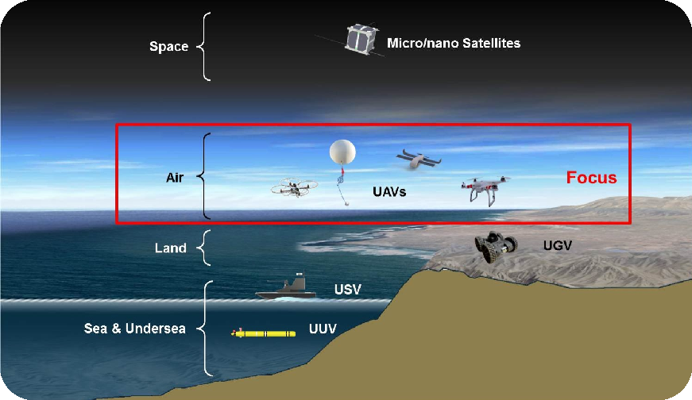

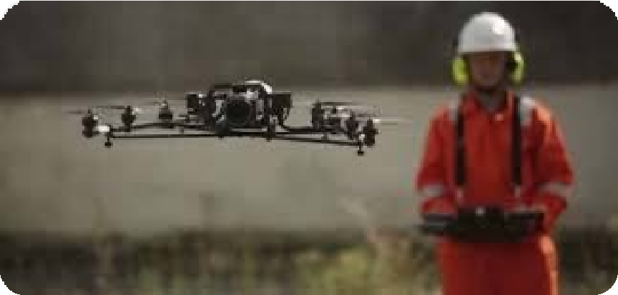
010 00 00: Introduction to UAS
010 01 01: Unmanned Aircraft (UA) & Unmanned Aircraft System (UAS)
Unmanned Aircraft (UA) Unmanned Aerial Vehicle (UAV) Remotely Piloted Aircraft (RPA)
UA / UAV / RPA is an aircraft that can be flown or used without a person on board to operate it. In our everyday life, they are also commonly known as ‘drones’
Unmanned Aircraft System consist of:
Unmanned Aircraft (UA)
Command and Control (C2) System
Ground-based Controller
Notes:
What is a UA / UAV / RPA?
Unmanned Aircraft (UA), Unmanned Aerial Vehicle (UAV), and Remotely Piloted Aircraft (RPA) all mean the same thing.
They are aircraft that fly without a person onboard. Meaning it is controlled remotely by a pilot on the ground.
nowadays, this are commonly known as drones,
What is an Unmanned Aircraft System (UAS)?
A UAS is not just the drone. It is the whole system needed to make the drone fly.
A UAS tipically comprises of:
Unmanned Aircraft (UA) – the drone itself
The controller – what the pilot uses to fly
And the Communication link – how the controller talks to the drone

Slide 4
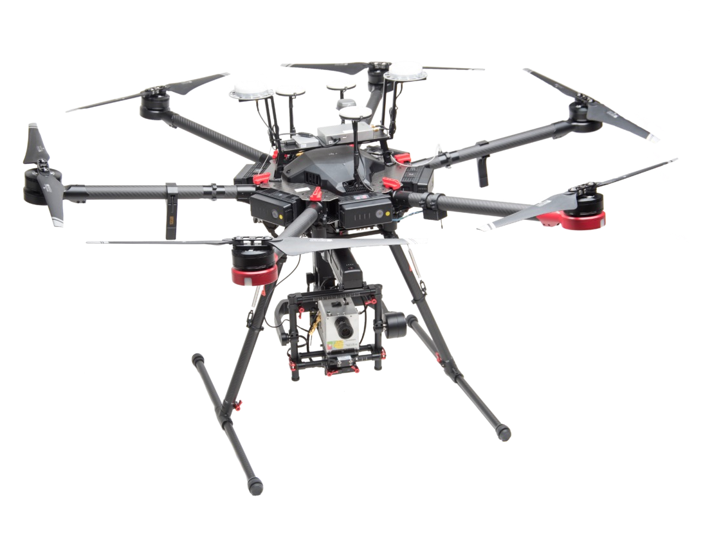
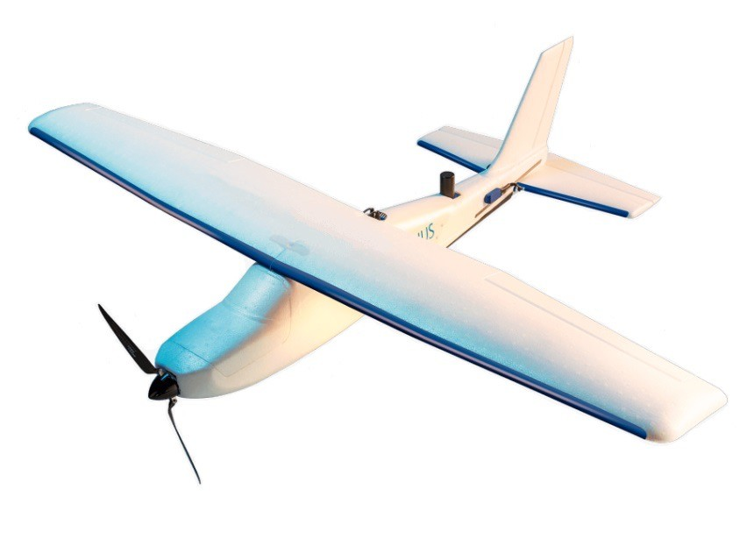
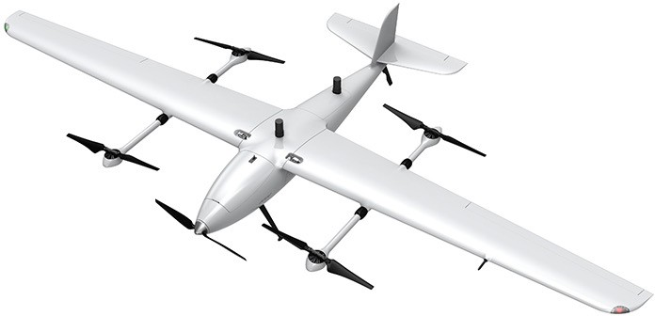
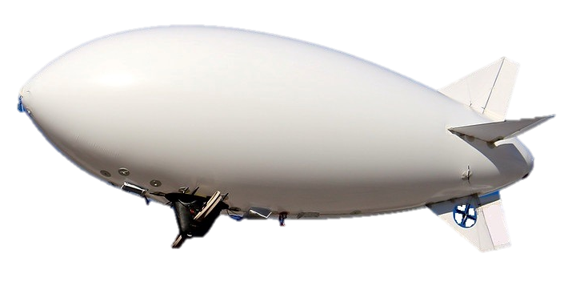
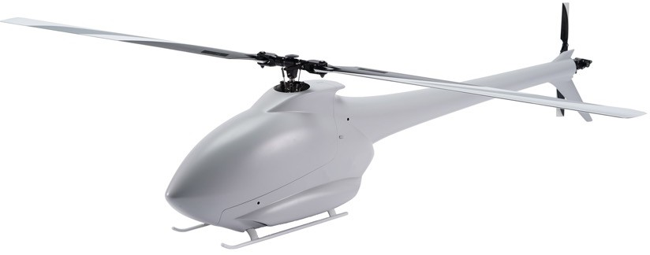
010 01 02: Different categories of UA and its operating principles:
Unmanned Aircraft (UA)
1. Aeroplane
2. Rotorcraft
i. Multirotor
3. Powered-lift
4. Airship
ii. Helicopter
Notes:
These are the 4 categories of UA mentioned in the ANR 101,
Aeroplane
Rotorcraft , which has two sub categories (multi-rotor and helicopter)
Powered lift
And airship

Slide 5
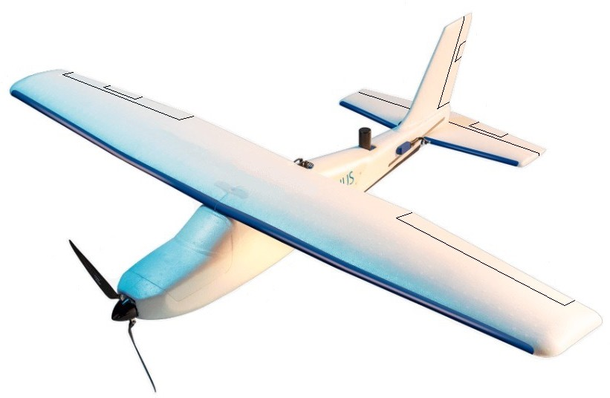
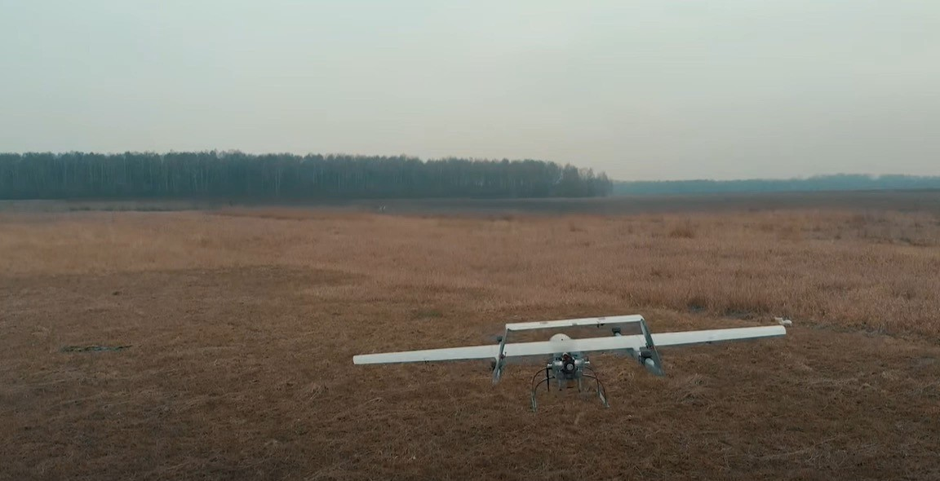

1. Aeroplane a power-driven heavier-than- air aircraft, deriving its lift in flight chiefly from aerodynamic reactions on surfaces which remain fixed under given conditions of flight.
2. Powered-lift a power-driven heavier- than-air aircraft capable of Vertical Take- Off, vertical Landing, and low-speed flight,
which depends principally on engine-
driven lift devices or engine thrust for the
lift during these flight regimes and on non- rotating aerofoil(s) for lift during horizontal flight.
Fixed-wings to generate LIFT
Fixed-wings for Horizontal Flight
Rotors for Vertical Flight
Notes:
What is an Aeroplane? (Simple Explanation)
An aeroplane is:
A powered aircraft (it uses an engine or motor),
That is heavier than air aircraft,
And gets its lift mainly from airflow over its wings. It uses its fixed wings to generate lift
What is a Powered-Lift Aircraft? (Simple Explanation)
A powered-lift aircraft is:
A powered, heavier-than-air aircraft,
That can take off vertically, land vertically, and fly at low speed, Because it uses the engine’s thrust or engine-driven lift devices to lift off the ground.
During normal (horizontal) flight, it uses non-rotating wings (fixed wings) to generate lift — similar to an aeroplane.

Slide 6


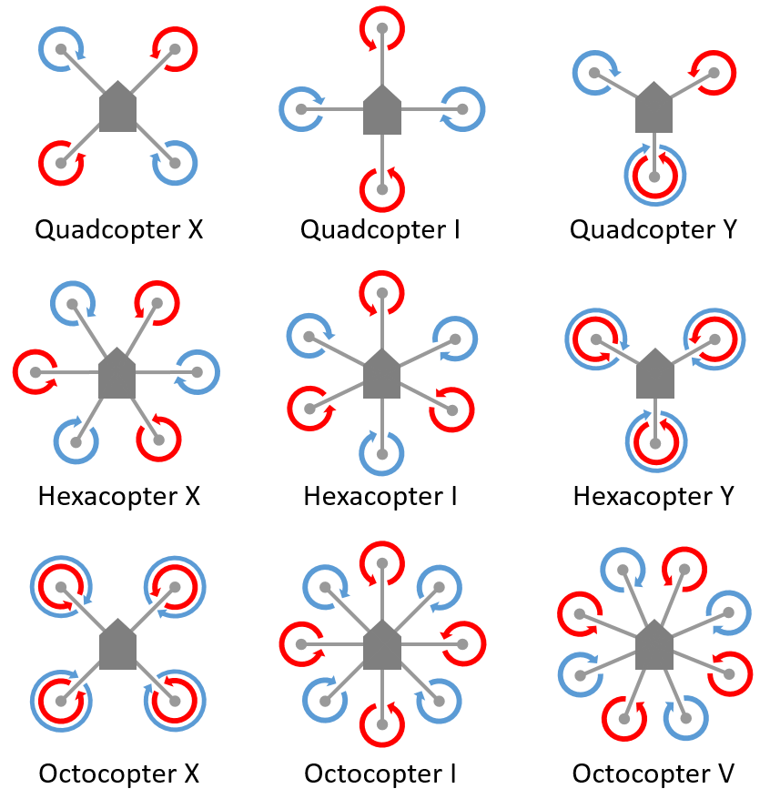
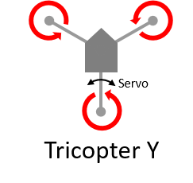
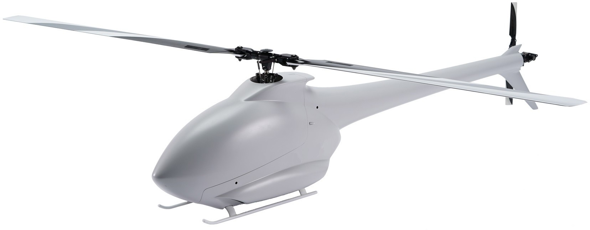
3. Rotorcraft a power-driven heavier-than-air aircraft supported in flight by the reactions of the air on one or more rotors. Rotorcrafts includes helicopters and multi-copters or multirotor.
i. Helicopter means a heavier-than-air aircraft supported in flight chiefly by the reactions of the air on one or more power driven rotors on substantially vertical axes.
ii. Multirotor is a rotorcraft with more than two lift-generating rotors.
FPV stands for first-person view. So, when it comes to flying an FPV drone, essentially this means that pilots of FPV drones see what the drone sees.
Notes:
What is a Rotorcraft? (Simple Explanation)
A rotorcraft is:
A powered, heavier-than-air aircraft,
That is kept in the air by one or more rotating blades, called rotors.
The spinning rotors create the lift needed for flight — not wings.
Rotorcraft include:
Helicopters
Multicopters / Multirotors (e.g., drones with 3, 4, 6, or 8 rotors)

Slide 7
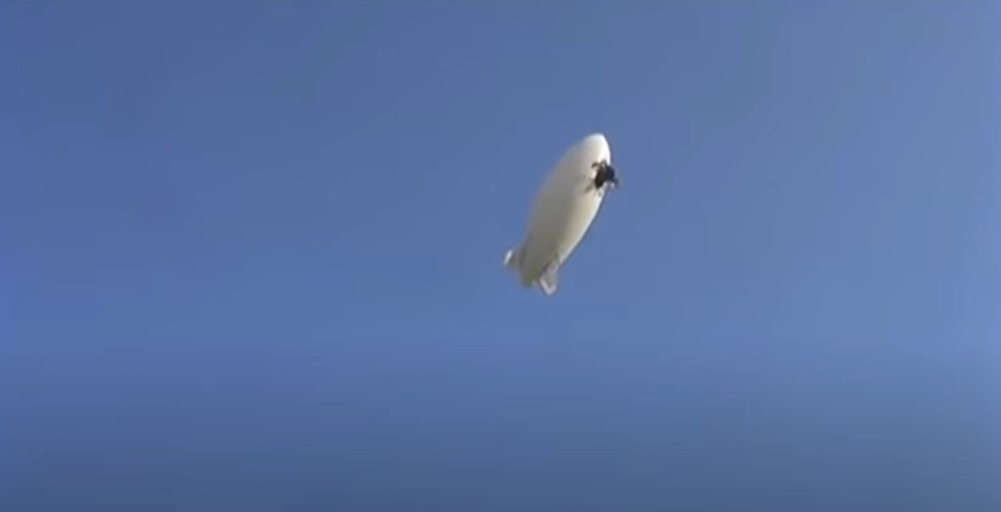
4. Airship or what they called dirigible balloon; this type of aircraft is “lighter than air” it means that it uses buoyant gas to hover.
Envelope
Gondola
Main Rotors
Tail Rotor
Notes:
What is an Airship? (Dirigible Balloon)
An airship is:
A lighter-than-air aircraft,
Which means it floats in the air using a buoyant gas (like helium or hot air),
Can hover or move slowly in the air.
Other names: sometimes they call this Dirigible or Dirigible balloon.
All dirigibles are airships, but not all balloons are dirigibles — the key difference is steerability.

Slide 8

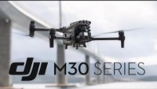
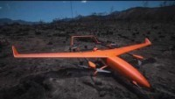
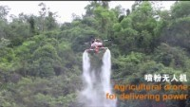


010 01 03: Applications of UAS
UA used in a wide range; Government (public) / military; Commercial and; Consumer (private). UA technology is continuously evolving and being put to several innovative uses around the world.
As every category of UA have different advantages and disadvantages. It is Important to choose the right UA for the flight operation.
Notes:
1. Fixed-Wing (Aeroplane) UAS
Pros:
Efficient for long-range and wide-area mapping or surveillance
Can cover large areas quickly
Good endurance / battery life
Cons:
Cannot hover, so not ideal for detailed inspections (like building façades)
Needs runway or catapult for takeoff/landing (some VTOL variants exist)
Typical Uses:
Large-area mapping (forests, farmland)
Coastal or border surveillance
Disaster area assessment
2. Powered-Lift UAS
Pros:
Can take off and land vertically (VTOL), so no runway needed
Can hover for short periods for detailed inspections
Can transition to efficient horizontal flight for distance
Cons:
More mechanically complex → higher maintenance
Limited hovering endurance compared to rotorcraft
Typical Uses:
Infrastructure inspection (bridges, tall buildings)
Surveying areas that require both hover and horizontal flight
Emergency response in hard-to-reach areas
3. Rotorcraft (Helicopters / Multirotors)
Pros:
Excellent hovering capability → ideal for façade or tower inspections
Can operate in tight spaces
Can deploy payloads (cameras, sensors) easily
Cons:
Shorter flight endurance than fixed-wing
Covers smaller areas per flight
More sensitive to wind conditions
Typical Uses:
Building façade inspections
Power line / tower inspections
Close-range aerial photography
Search and rescue
4. Airship / Dirigible
Pros:
Can hover for very long durations
Low energy consumption
Very stable platform → good for sensors and cameras
Cons:
Slow → not suitable for time-sensitive missions
Affected by wind and weather conditions
Bulky → needs large storage or hangar
Typical Uses:
Long-term surveillance (coastal monitoring, border security)
Environmental monitoring (air quality, wildlife)
Broadcast or advertising platforms

Slide 9














010 02 00: UAS Components and Systems
010 02 01: Major systems of UAS
UAS Major System
Power and Electrical System
Propulsion System
Flight Control and Navigation System
Command and Control (C2) System
Ground Control System
- Battery
- BEC
- Motor
- ESC
- Blades / Propeller
- Flight Controller
- Sensors
GNSS
Servo
- Communication between Transmitter & Receiver
- Radio frequencies
- Pilot
- Transmitter / Controller
Notes:
A UAS is made up of several key systems that work together to make it fly safely and perform its flight missions.
1. Power and Electrical System
Provides energy to all components
Includes:
Battery – of course UA need energy, or fuel to power all the necessary components
BEC / Power Distribution Board – distributes or regulate different voltages or power to motors, sensors, and electronics
2. Propulsion System
Makes the aircraft move and generate lift
Includes:
Motors – drive the propellers or rotors
ESC (Electronic Speed Controller) – controls motor speed
Blades / Propellers – push air to generate lift
3. Flight Control & Navigation System
Keeps the aircraft stable and on course
Includes:
Flight Controller – the “brain” of the drone
Sensors – gyroscope, accelerometer, barometer, etc.
GNSS (GPS/GLONASS) – position and navigation
Servo – moves control surfaces (for fixed-wing or powered-lift)
4. Command & Control (C2) System
Communication link between pilot and aircraft
Includes:
Transmitter (TX) – sends commands
Receiver (RX) – receives commands
5. Ground Control System
Human operator / pilot interface
Includes:
Controller – joystick, tablet, or laptop
Pilot – monitors flight and sends commands

Slide 10
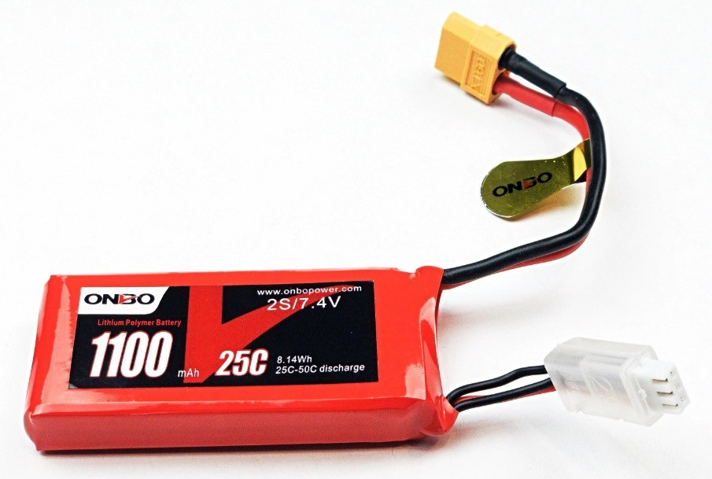
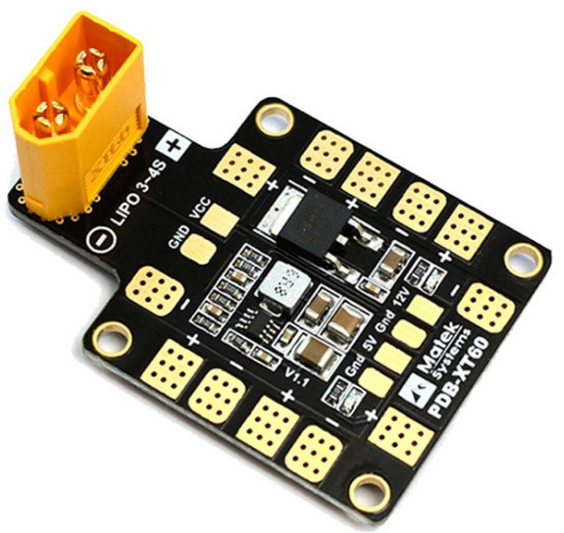
010 02 02: Functions of the different UAS components under each major system and compare the differences across the different categories of UA
1. Power and Electrical System consists of supply and all of the elements needed to distribute electrical power, including lines, transformers, and other equipment.
Cell Count / Voltage 2S / 7.4V
- Number of cell multiply by 3.7V
- Voltage potential energy difference between the positive and negative terminals
Lithium Polymer Battery
Battery Elimination Circuit
- BEC regulates the voltage from the battery to a lower voltage required to other components of the UA.
Capacity (maH)
Discharge Rating
Amount of energy the battery can store
Discharge rate, or “C” rating, is the rate in which a battery can be safely discharged and in a healthy state
Notes:
Lithium Polymer (LiPo) Battery
LiPo battery is the most common type of battery used in UAS.
Stores electrical energy to power the motors, electronics, and other systems.
Lightweight and high energy density → ideal for drones.
Must be handled carefully:
Avoid overcharging or over-discharging
Avoid physical damage or puncture
What is a BEC? (Battery Eliminator Circuit)
A BEC regulates voltage from the main battery to the correct level needed by other components of the UAS.
Prevents overvoltage damage to electronics like:
Flight controller
Servos
Sensors

Slide 11
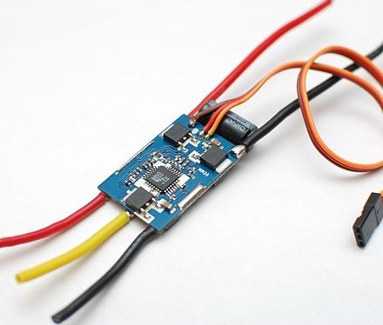
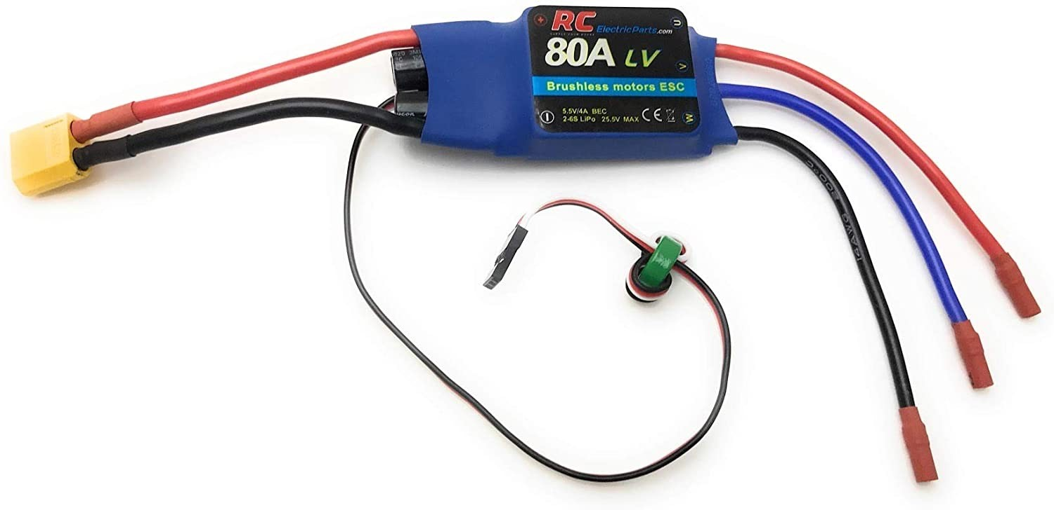
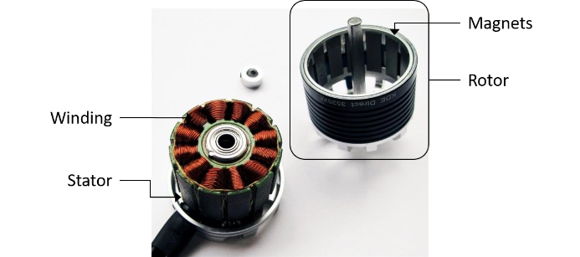
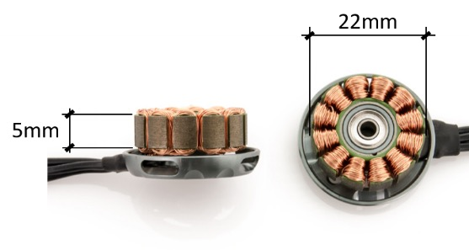
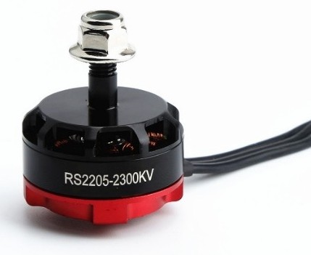
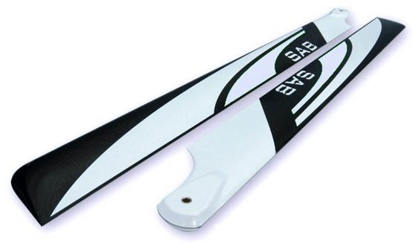
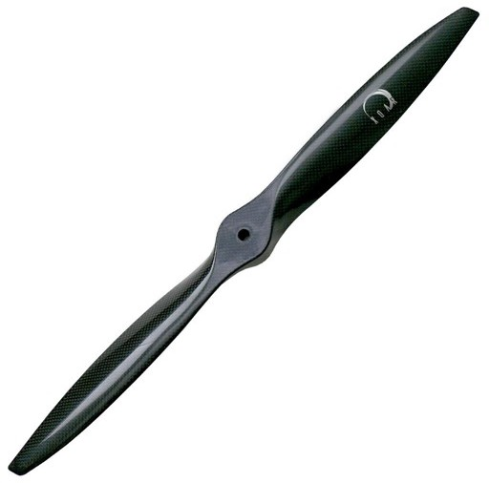
2. Propulsion System a machine that produces thrust to push an object forward.
Brushless Electric Motor
Also known as an electronically commutated motor (ECM or EC motor) or
synchronous DC motor, is a synchronous motor using a direct current (DC) electric power supply. It uses an electronic controller to switch DC currents to the motor windings producing magnetic fields which effectively rotate in space and which the permanent magnet rotor follows.
Electronic Speed Controller
Is what allows the flight controller to control the speed, braking, direction
and also provide monitoring and fault tolerance of the UA motors.
ESC with BEC
Aircraft Propeller
Is an aerodynamic device which converts rotational energy into propulsive
force creating thrust which is approximately perpendicular to its plane of rotation.
The KV rating of a brushless motor is the ratio of the motor’s unloaded rpm to the peak voltage on the wires connected to the coils.
For example, a 2300KV motor powered by an 7.4V battery would spin at 17,020 rpm (2300 x 7.4) with no load.
Notes:
Brushless Electric Motor (BLDC Motor)
Also called ECM / EC motor.
Type of motor powered by DC electricity.
Uses an electronic controller to switch current in the motor windings.
Creates a rotating magnetic field, which the rotor (permanent magnet) follows to spin the motor.
Advantages:
More efficient than brushed motors
Less maintenance (no brushes to wear out)
High power-to-weight ratio → ideal for drones
Electronic Speed Controller (ESC)
ESC controls the motors of the UAS.
Allows the flight controller to:
Adjust motor speed
Apply braking
Change direction (for some setups)
Monitor motor performance and detect faults
Propeller = The device that pushes the drone forward or generate lift
Works by turning motor power into thrust

Slide 12

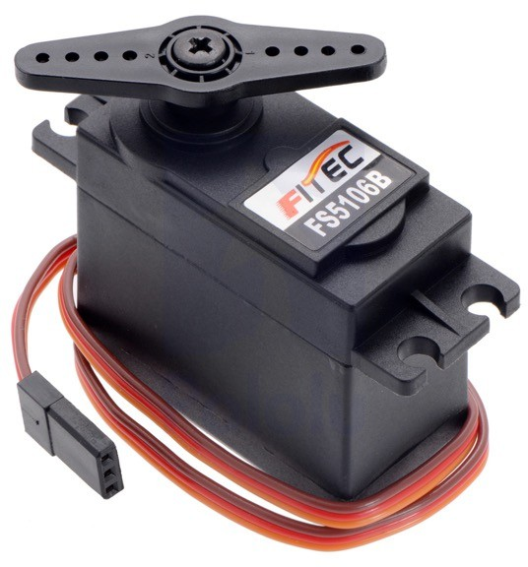
3. Flight Control and Navigation System
Flight Controller
Sensors
Is an integrated circuit (IC) board that manages the UA’s flight.
It is the brain of the UA
Is a device that will keep your aircraft stable.
- Sensors works by collecting necessary data and feeding to the flight controller for the required computation and execution for movement
i. Accelerometer and Gyroscope
- These are the inertial sensors on your UA. The accelerometer measures acceleration forces, and the gyro measures rotational forces. By combining these measurements the flight controller is able to calculate the UA’s current attitude (angle it is flying at) and perform necessary corrections.
ii. Compass (magnetometer)
- The compass sensor, measures the magnetic force, just like a compass. This
sensor is important for rotorcraft because the accelerometer and gyroscope sensors are not enough to let the flight controller know what direction the UA is facing. On fixed wing drones this easy since it can only fly in one direction.
iii.
Barometer
- A barometer is a pressure sensor that you use to measure the aircrafts altitude.
Servo
- Are electronic devices and rotary or linear actuators that
rotate and push parts of a machine with precision. Servos are mainly used on angular or linear position and for specific velocity, and acceleration.
iv. Airspeed sensor
- An airspeed sensor is another form of a pressure sensor, but instead of measuring altitude, this measures for fast the air is passing the aircraft. It does this by comparing the dynamic and static pressure via a pitot tube.
v. Detection Sensors
- Sensors which includes vision sensors, infrared sensors and sonar/LiDAR to assist the flight controller to perform 3D mapping and flight trajectory prediction.
UA’s also have the ability to integrate distance sensors. These can range from ultrasonic distance sensors that send a ultrasonic ping and measure
how long it takes to bounce back of objects in front of it.
-
Notes:
Flight Controller
The flight controller is the brain of the UA.
It is an integrated circuit (IC) board that manages the drone’s flight.
Keeps the aircraft stable and balanced during flight by:
Receiving data from sensors (gyro, accelerometer, compass, etc.)
Sending commands to motors and servos
Servo - In UAS, servos are mainly used to move control surfaces (like rudders, ailerons, or tilt mechanisms) accurately.
1. Accelerometer & Gyroscope
Accelerometer → measures acceleration forces
Gyroscope → measures rotational forces
Together, they help the flight controller determine the UA’s attitude (tilt/angle) and make corrections.
2. Compass (Magnetometer)
Measures magnetic direction, just like a handheld compass.
Helps the flight controller know which way the UA is facing.
Especially important for rotorcraft, where orientation isn’t fixed.
3. Barometer
Measures air pressure to estimate altitude.
4. Airspeed Sensor
Measures air speed using dynamic and static pressure (Pitot tube).
Useful for fixed-wing aircraft to maintain proper flight.
5. Vision, Infrared, and LiDAR/Sonar Sensors
Help the UA detect obstacles, map 3D environments, and predict flight trajectory.
Includes distance sensors (ultrasonic or LiDAR) to measure distance to objects in front of the UA.
Accelerometer + Gyro → orientation/tilt
Compass → direction
Barometer → altitude
Airspeed sensor → speed in air
Vision/LiDAR/Sonar → obstacle detection & mapping

Slide 13

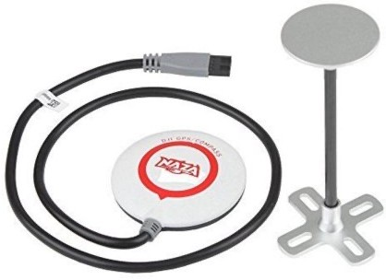
Navigation System
a set of equipment designed to assist or automate navigation in a vehicle, ship, or aircraft.
Use to locate a position; Navigate from one location to another; Track/monitor object or movement; Mapping
Three satellites are needed by the receivers to determine position, while the fourth enhances the measurement and provides the ability to calculate elevation
GPS Module
Global Positioning System (GPS) - USA
Global Orbiting Navigation Satellite System (GLONASS) – Russia
Galileo – EU
BeiDou Navigation Satellite System (BDS) – China
Quasi-Zenith Satellite System (QZSS) – Japan
Indian Regional Navigation Satellite System (IRNSS) – India
- The monitoring stations checks the exact altitude, position, speed, and overall health of the orbiting satellites.
Notes:
Navigation System
A navigation system is a set of equipment that helps the UA know where it is and where to go.
Functions include:
Locate current position
Navigate from one point to another
Track or monitor objects
Mapping areas
How it works:
Three satellites are needed to determine the UA’s position.
A fourth satellite improves accuracy and allows the UA to calculate elevation/altitude.

Slide 14
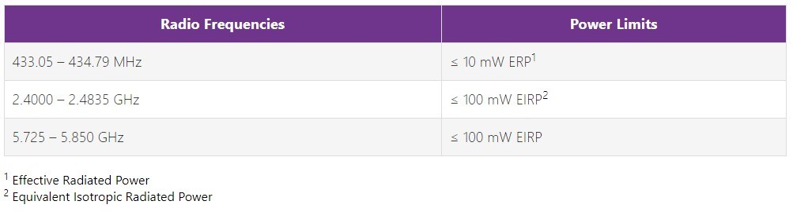
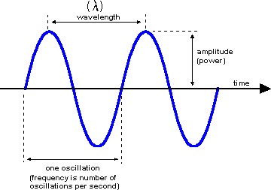
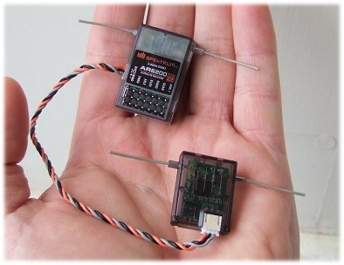
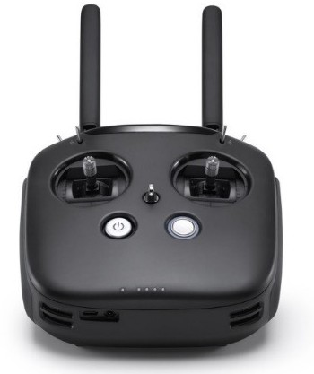
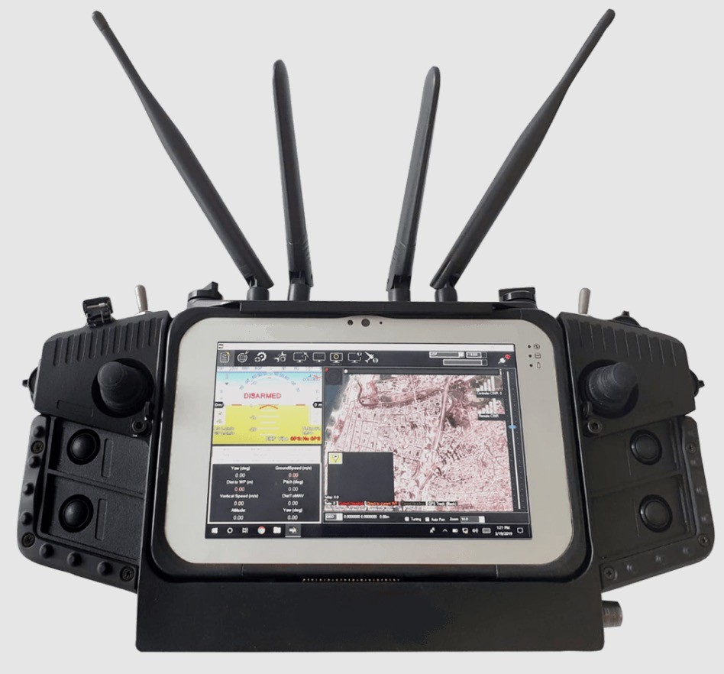
4. Command and Control (C2) System
Also referred to as Control and Non-Payload Communication (CNPC), refers to the communications link between a UA and its ground station that is responsible for the management and control of the aircraft. C2 links are an essential part of UA operations whether the aircraft is being directly remotely piloted by a human, or programmed to fly autonomously.
The commonly used radio frequencies and their corresponding power limits are as follows:
Receiver
- Is the device capable of receiving commands from the Radio Transmitter
Ground Control System
UA ground control station (GCS) is a land- or sea-based control centre that provides the facilities for human control of Unmanned Aircrafts (UA’s or "drones").
Portable GCS
Smaller UAs can be operated with a traditional "twin-stick". Extending
this setup with a laptop or tablet computer, data and video telemetry, and aerials, creates what is effectively a Ground Control Station.
The minimum channel required to pilot a multi-rotor is four channels.
Notes:
Command and Control (C2) System
Provides the communication link between the UA and its ground station.
Responsible for managing and controlling the aircraft.
Essential whether the UA is:
Remotely piloted by a human, or
Flying autonomously
Ground Control System (GCS)
The Ground Control Station (GCS) is a land- or sea-based control center for human operators to control UAs (drones).
Portable GCS:
Smaller drones can use a traditional twin-stick controller.
Adding a laptop/tablet, telemetry, and antennas creates a full GCS.
Minimum requirement:
A multi-rotor drone needs at least four channels to be controlled.

Slide 15
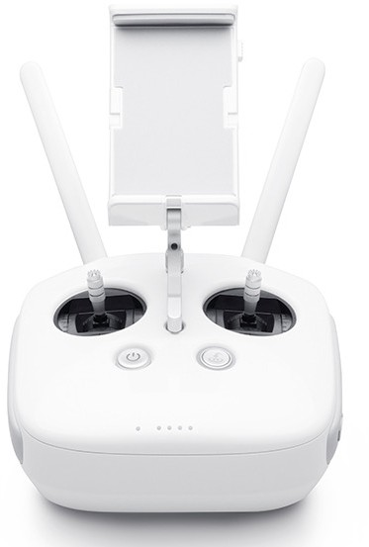


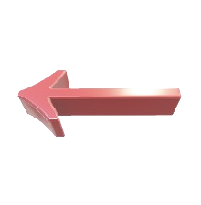
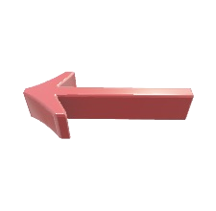

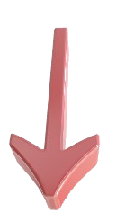


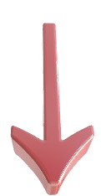
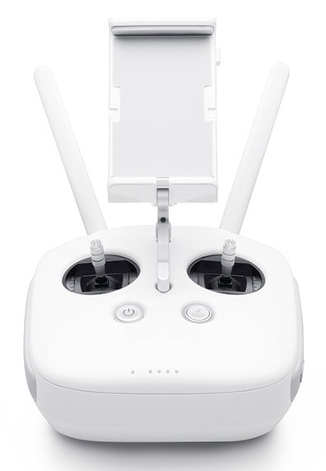

Control modes Mode 2
Mode 1
Throttle
Pitch
Pitch
Throttle
Yaw Left
Yaw Right
Roll Left
Roll Right
Yaw Left
Yaw Right
Roll Left
Roll Right
Throttle
Pitch
Pitch
Throttle
Mode 3
Mode 4
Pitch
Throttle
Throttle
Pitch
Roll Left
Roll Right
Yaw Left
Yaw Right
Roll Left
Roll Right
Yaw Left
Yaw Right
Pitch
Throttle
Throttle
Pitch
Headless mode is a built-in setting that makes it easy to know the orientation of your drone. Flying a drone in headless mode means that your drone “faces forward” no matter your position on the ground. The headless mode makes the drone respond to your controls irrelative to which way it’s actually facing, so that you don’t have to keep track of the drone’s orientation in flight.
Notes:
These are the different control modes. But the most common modes is the Mode 2, or the default mode in most consumer drones.
This is also tested. So you have to memorise these different controls for each modes

Slide 16
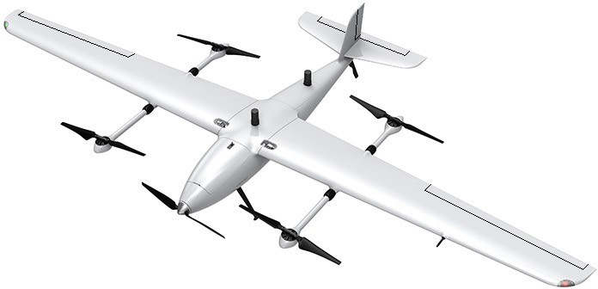
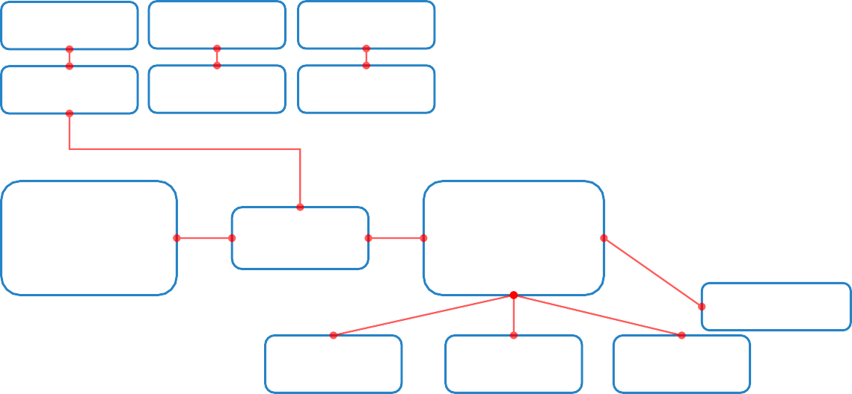
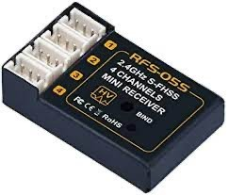
Stabilizer
(Vertical & Horizontal)
Rudder to Yaw
Stabilizer
(Vertical & Horizontal)
Wing
Elevator to Pitch
Fixed-wings for Horizontal Flight
Rudder to Yaw
Ailerons to Roll
Elevator to Pitch
Fuselage
(Body)
Ailerons to Roll
Fuselage
(Body)
Motor ^{[2]}
Receiver ^{[4]}
Rotor for Horizontal Flight
Gimbal / Camera
/ VTX
Rotors for Vertical Flight
Battery^{[1]}
BEC ^{[1]} / ESC ^{[2]}
_{FC} [3]
GNSS ^{[3]}
Servo 1 ^{[3]}
(Ailerons)
Servo 2 ^{[3]}
(Elevator)
Servo 3 ^{[3]}
(Rudder)
Motor 1 ^{[2]}
Motor 2 ^{[2]}
Motor 3 ^{[2]}
Motor 4 ^{[2]}
Motor 5 ^{[2]}
ESC 1 ^{[2]}
ESC 2 ^{[2]}
ESC 3 ^{[2]}
ESC 4 ^{[2]}
ESC 5 ^{[2]}
Motor ^{[2]}
Receiver ^{[4]}
GNSS ^{[3]}
Battery^{[1]}
BEC ^{[1]} / ESC ^{[2]}
Battery^{[1]}
_{BEC} [1]
_{FC} [3]
Gimbal / Camera / VTX
Receiver ^{[4]}
Servo 3 ^{[3]}
(Rudder)
Servo 1 ^{[3]}
(Ailerons)
Servo 2 ^{[3]}
(Elevator)
Servo 3 ^{[3]}
(Rudder)
Servo 1 ^{[3]}
(Ailerons)
Servo 2 ^{[3]}
(Elevator)

Slide 17

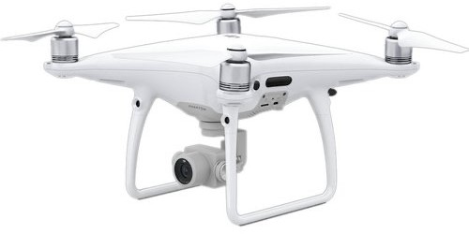
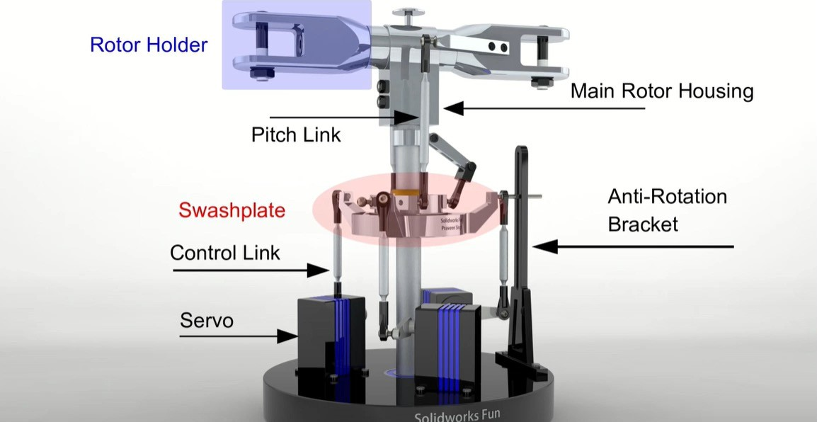
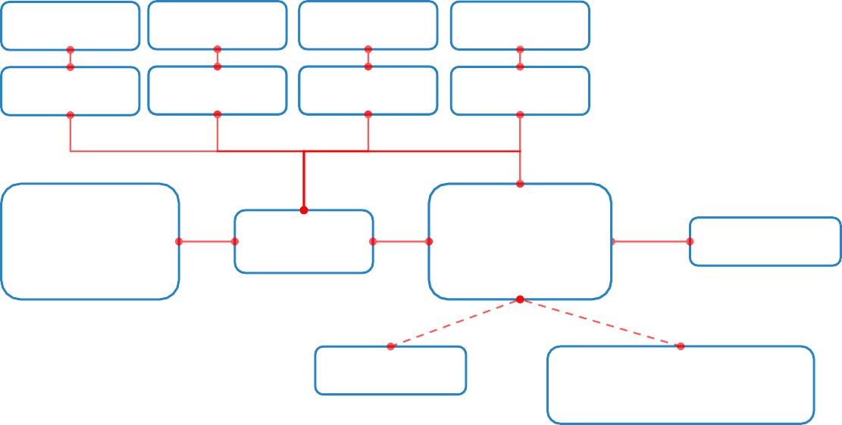
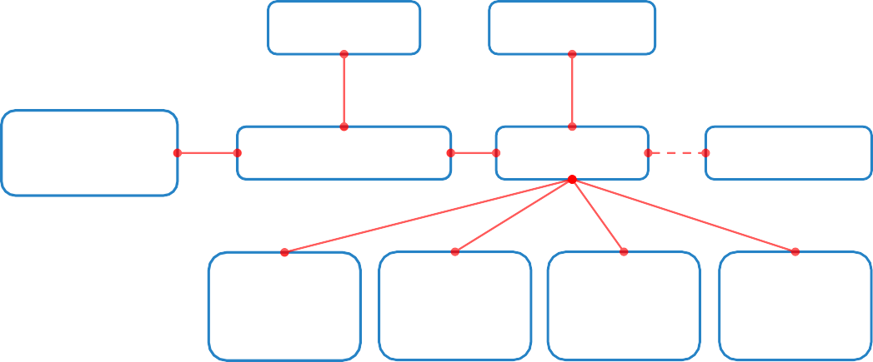
Main rotor
Tail rotor
Canopy / Shell
Vertical
Stabilizer
Rotors for Vertical & Horizontal Flights
Tail Boom
Skids /
Landing Gear
Shell (Body)
Payload
(Gimbal & Camera)
Sensors
Landing Gear
Motor 1 ^{[2]}
Motor 2 ^{[2]}
Motor 3 ^{[2]}
Motor 4 ^{[2]}
ESC 1 ^{[2]}
ESC 2 ^{[2]}
ESC 3 ^{[2]}
ESC 4 ^{[2]}
Motor ^{[2]}
Receiver ^{[4]}
Battery^{[1]}
_{BEC} [1]
_{FC} [3]
Receiver ^{[4]}
Battery^{[1]}
BEC ^{[1]} / ESC ^{[2]}
_{FC} [3]
GNSS ^{[3]}
GNSS ^{[3]}
Gimbal / Camera / VTX
Servo 1 ^{[3]}
(Main rotor)
Servo 2 ^{[3]}
(Main rotor)
Servo 3 ^{[3]}
(Main rotor)
Servo 4 ^{[3]}
(Tail rotor)

Slide 18
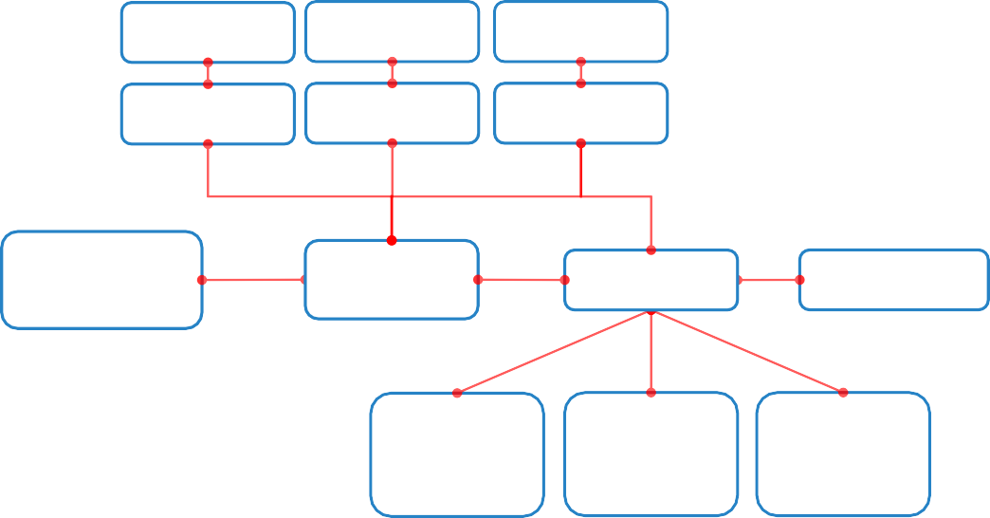
Motor 1 ^{[2]}
Motor 2 ^{[2]}
Motor 3 ^{[2]}
Envelope
Stabilizer
(Vertical & Horizontal)
Rudder
ESC 1 ^{[2]}
ESC 2 ^{[2]}
ESC 3 ^{[2]}
Elevator
Battery^{[1]}
_{BEC} [1]
_{FC} [3]
Receiver ^{[4]}
Gondola
Servo 1 ^{[3]}
(Main rotor)
Servo 2 ^{[3]}
(Rudder)
Servo 3 ^{[3]}
(Elevator)
Main rotor
Tail rotor

Slide 19

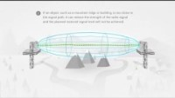
010 02 03: Operation of the UAS C2 link
Importance of radio-line-of-sight and causes of radio interference and loss link
Radio transmission requires a clear path between antennas known as radio line of sight. Line of sight is the direct free- space path that exists between two points.
Microwave antennas and high-voltage lines create strong interference that can affect the radio transmissions that control your UA. The following will cause degradation of the transmitter signal:
Free-space loss - Your signal travels through the atmosphere. The farther your signal travels, the more it loses strength.
Absorption loss - If your signal passes through an object that is not transparent to radio signals.
Diffraction - Signal loss happens from diffraction when an object (building, tree, wall) appears between the transmitter and receiver.
iii.
Multipath interference - Reflected radio signals can split and reach the receiver from a number of different paths.
Terrain - Topography has a significant effect on signal transmission. Hills can obstruct the path and considerably weaken the signal, often making reception impossible.
Buildings and vegetation - Radio signals can be significantly affected by buildings because they can reflect or absorb radio waves.
Notes:
Radio Line-of-Sight (LOS) & Communication
Radio Line-of-Sight (LOS):
Radio transmission requires a clear, unobstructed path between the UA and ground station antennas.
LOS is the direct free-space path connecting two points.
Importance:
Ensures reliable communication between UA and pilot.
Prevents loss of control during flight.
Causes of Radio Interference & Link Loss:
Physical obstructions (buildings, trees, mountains)
Electromagnetic interference from other devices
Weather conditions (heavy rain, fog)
Distance exceeding maximum range of the radio link
Free-Space Loss
The farther a signal travels through the atmosphere, the weaker it becomes.
Absorption Loss
Signals weaken when passing through objects that block radio waves.
Diffraction
Signal bends around objects like buildings, trees, or walls, causing loss.
Multipath Interference
Reflected signals can arrive at the receiver via multiple paths, causing interference.
Terrain Effects
Hills or uneven ground can block or weaken signals, sometimes preventing reception.
Buildings & Vegetation
Can reflect or absorb radio waves, reducing signal strength.

Slide 20

020 00 00: Principles of Flight
Module 2

Slide 21


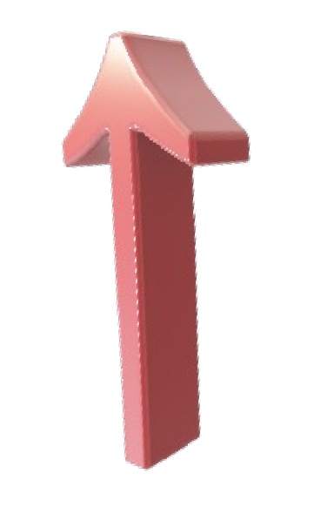
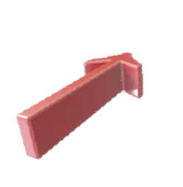

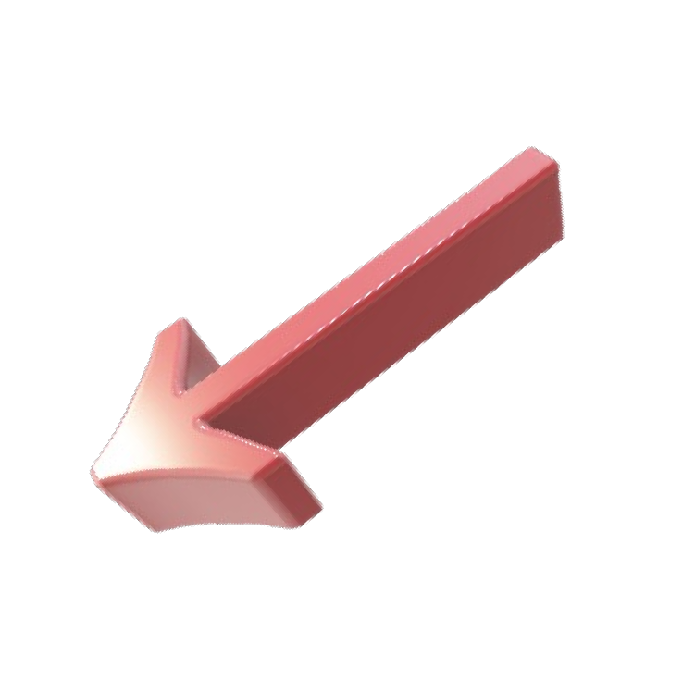

020 01 00: Aerodynamics
020 01 01: Identify the four forces of flight
1. Weight the combined load of the aircraft itself. Weight is a force that pulls the aircraft downward because of the force of gravity. It opposes lift and acts vertically downward through the aircraft’s center of gravity (CG).
Lift
Drag
Lift is a force that is produced by the dynamic effect of the air acting on the airfoil, and acts perpendicular to the flight path through the center of lift (CL).
Thrust the forward force produced by the powerplant/ propeller or rotor.
Drag a rearward, retarding force caused by disruption of airflow by the wing, rotor, fuselage, and other protruding objects. As a general rule, drag opposes thrust and acts rearward parallel to the relative wind.
Thrust
Weight
Notes:
Four Forces of Flight
Weight
The combined load of the aircraft (aircraft, payload, fuel, etc.)
A force pulling the aircraft downward due to gravity
Acts vertically downward through the center of gravity (CG)
Opposes lift
Lift
Force produced by air flowing over the wings or rotors (airfoil)
Acts perpendicular to the flight path through the center of lift (CL)
Opposes weight and keeps the aircraft in the air
Thrust
Forward force produced by the engine, propeller, or rotor
Pushes the aircraft through the air
Opposes drag
Drag
Rearward force caused by air resistance against wings, fuselage, or protrusions
Acts parallel to the relative wind
Opposes thrust

Slide 22







020 01 02: Describe aerofoil interaction with airflow
An airfoil (American English) or aerofoil (British English) is the cross-sectional shape of an object whose motion through a gas is capable of generating significant lift, such as a wing, a sail, or the blades of propeller, rotor, or turbine.
The lift on an airfoil is primarily the result of its Angle of Attack (AOA). When oriented at a suitable angle, the airfoil deflects the oncoming air (for fixed-wing aircraft, a downward force), resulting in a force on the airfoil in the direction opposite to the deflection.
In aeronautics, downwash is the change in direction of air deflected by the aerodynamic action of an airfoil, wing, or helicopter rotor blade in motion, as part of the process of producing lift.
Leading Edge
Chord Line
Low Pressure High Velocity
Camber Line
Airflow
AOA
High Pressure Low Velocity
Trailing Edge
Notes:
Airfoil (Aerofoil)
Definition:
The cross-sectional shape of an object (wing, sail, propeller or rotor blade) that can generate lift when moving through air.
How Lift is Generated:
Angle of Attack (AOA): The angle between the airfoil and the oncoming airflow.
When the AOA is correct, the airfoil deflects the air downward (downwash), creating lift upward.
Downwash: The change in direction of airflow caused by the airfoil, contributing to lift.
Key Parts of an Airfoil
Leading Edge – The front edge of the airfoil that first meets the airflow.
Trailing Edge – The rear edge where air leaves the airfoil.
Chord Line – An imaginary straight line connecting the leading and trailing edges.
Camber – The curvature of the airfoil, which affects lift.
Interaction with Airflow
Air splits at the leading edge:
Some flows over the top surface → accelerates → lower pressure
Some flows along the bottom surface → slower → higher pressure
Pressure difference between top and bottom surfaces generates lift.
Simple summary for students
Airfoil = Wing or blade shape that makes lift
AOA & airflow deflection = main factors for lift
Leading edge, trailing edge, chord line help define the shape and behavior in air

Slide 23




Types of Drag
Parasite drag is comprised of all the forces that work to slow an aircraft’s movement. As the term parasite implies, it is the drag that is not associated with the production of lift:
Form drag is the portion of parasite drag generated by the aircraft due to its shape and airflow around it. Examples include the engine cowlings, antennas, and the aerodynamic shape of other components
Interference drag comes from the intersection of airstreams that creates eddy currents, turbulence, or restricts smooth airflow. For example, the intersection of the wing and the fuselage at the wing root has significant interference drag. Air flowing around the fuselage collides with air flowing over the wing, merging into a current of air different from the two original currents.
iii. Skin friction drag is the aerodynamic resistance due to the contact of moving air with the surface of an aircraft.
Notes:
Parasite Drag
Definition:
Drag that slows the aircraft but is not related to lift.
Called “parasite” because it does not contribute to keeping the aircraft in the air.
Types of Parasite Drag
Form Drag is a type of parasite Caused by the shape of the aircraft and airflow around it.
Examples: engine cowlings, antennas, fuselage shape
Interference Drag
Caused when different airstreams meet and create turbulence or eddies.
Example: where the wing meets the fuselage at the wing root
Skin Friction Drag
Caused by air rubbing against the aircraft’s surface.
Depends on surface roughness and area

Slide 24




2. Induced drag that part of the drag on an aerofoil which arises from the development of lift.
An airfoil (wing or rotor blade) produces the lift force by making use of the energy of the free airstream.
Whenever an airfoil is producing lift, the pressure on the lower surface of it is greater than that on the upper surface (Bernoulli’s Principle).
As a result, the air tends to flow from the high pressure area below the tip upward to the low pressure area on the upper surface. In the vicinity of the tips, there is a tendency for these pressures to equalize, resulting in a lateral flow outward from the underside to the upper surface.
This lateral flow imparts a rotational velocity to the air at the tips, creating vortices that trail behind the airfoil.
Wingtip vortices are circular patterns of rotating air left behind a wing as it generates lift.
Fixed wing aircraft, when an aircraft flies at or below approximately HALF THE LENGTH OF THE AIRCRAFT'S WINGSPAN above the ground or water there occurs an often-noticeable GROUND EFFECT. The result is lower induced drag on the aircraft. This is caused primarily by the ground or water obstructing the creation of wingtip vortices and interrupting downwash behind the wing.
Notes:
Induced Drag
Definition:
Drag that is produced as a byproduct of generating lift.
Occurs whenever an airfoil (wing or rotor blade) creates lift.
How Induced Drag Happens
Pressure Difference:
Lower surface pressure > upper surface pressure (Bernoulli’s Principle).
Air flows from high pressure below the wing to low pressure above the wing near the tips.
Wingtip Vortices:
Lateral flow at the tips creates rotating air patterns called vortices.
These vortices trail behind the wing, producing induced drag.
Ground Effect:
When flying close to the ground (about half the wingspan height), the ground interrupts wingtip vortices.
Result: lower induced drag → easier to lift and more efficient flight near the surface.

Slide 25




020 01 03 Describe aerodynamic stall
In fluid dynamics, a stall is a reduction in the lift coefficient generated by a foil as angle of attack increases. This occurs when the critical angle of attack of the foil is exceeded.
Stalls in fixed-wing flight are often experienced as a sudden reduction in lift as the pilot increases the wing's angle of attack and exceeds its critical angle of attack (which may be due to slowing down below stall speed in level flight)
Symptoms of Stall
“Angle of Attact” refers to the relationship of chord line to direction of oncoming airflow. At low AOA, airflow is smooth and moderate lift is the result
Reducing air speed
Reducing control effectiveness
Pre-stall buffet
As AOA increase, lift forces build to a peak then the airflow begins to move away from the wing, starting near the trailing edge ang going forward, until…….
Basic Stall recovery
P - Pitch nose-down to decrease the AOA. R - Reduce the bank by levelling the wings. A - Add power as needed.
R - Return to the desired flight path.
…Stall occurs. As the AOA exceeds the maximum AOA, the airflow breaks away and lift is destroyed.
Notes:
Stall
Definition:
A stall happens when a wing loses lift because the angle of attack (AOA) becomes too high.
The critical AOA is the maximum angle before airflow separates from the wing.
Angle of Attack (AOA)
The angle between the chord line of the wing and the oncoming airflow.
Low AOA: Smooth airflow → moderate lift
Increasing AOA: Lift increases until a peak
Beyond critical AOA: Airflow separates from the wing → lift drops → stall
Symptoms of Stall
Reduced airspeed
Reduced control effectiveness
Pre-stall buffet (shaking or vibration)
Basic Stall Recovery (P-R-A-R)
P – Pitch nose-down → decrease AOA
R – Reduce bank → level the wings
A – Add power → regain airspeed if needed
R – Return → to desired flight path

Slide 26



020 01 04: Describe aerodynamic spin
A spin is a yaw aggravated stall which results in rotation about the spin axis. The aircraft follows a steep, "corkscrew" like, downward path. Spins can be entered, either intentionally or unintentionally, from any flight attitude and at practically any airspeed.
Basic Spin recovery
P - Power: The throttle should be moved to the idle position to reduce thrust.
A - Ailerons: Ailerons should be neutralized.
R - Rudder: Full opposite rudder input should be applied until the rotation is stopped. If the aircraft is rotating to the left, right rudder should be applied. Once the spinning stops, the rudder should be neutralized.
E - Elevator: Quick forward pressure should be applied to break the stall and gain airflow over the wings. Once the aircraft gains lift, back pressure should be applied gradually so as not to stall again.
Incipient - The incipient phase of a spin is the stall and spin entry, up to about 2 turns in the spin.
Fully Developed - When the airspeed and rotation
stabilize, considered developed.
the spin is
fully
Recovery -
Recovery occurs when the pilot
applies proper inputs to counter the spin and the aircraft regains lift and control function.
Notes:
Spin
Definition:
A spin is a yawed, aggravated stall.
The aircraft rotates around its spin axis and descends in a steep, corkscrew-like path.
Spins can occur intentionally or unintentionally, from almost any attitude or airspeed.
Phases of a Spin & Recovery
Incipient Spin
Entry phase of the stall and spin (up to ~2 turns)
Aircraft is starting to rotate
Recovery: Pilot applies initial corrective inputs to stop rotation
Fully Developed Spin
Rotation and airspeed stabilize
Aircraft maintains a steady corkscrew descent
Recovery: Pilot applies full spin recovery procedure to stop rotation, regain lift, and resume normal flight

Slide 27






020 01 05: Describe aerodynamic stability
Centre of Gravity (CG) and Centre of Pressure (CP), and how they affect stability
The Centre of Gravity (CG) is the specific point where the mass or weight of an aircraft may be said to centre; that is a point which the aircraft would balance.
The Center of Pressure (CP) is the point where the total sum of a pressure field acts on a body. In aerospace, this is the point on the airfoil (or wing) where the resultant vector (of lift and drag) acts.
CG
Notes:
Centre of Gravity (CG) & Centre of Pressure (CP)
Centre of Gravity (CG)
The point where the aircraft’s weight is balanced.
Acts as the average location of mass.
Importance:
Proper CG ensures aircraft stability and controllability.
If CG is too far forward → nose-heavy → harder to lift
If CG is too far aft → tail-heavy → aircraft may become unstable
Centre of Pressure (CP)
The point where the total aerodynamic force (lift + drag) acts on a wing or airfoil.
Changes position with angle of attack and flight conditions.
Importance:
CP affects aircraft stability.
If CP is ahead of CG → aircraft tends to nose down
If CP is behind CG → aircraft tends to pitch up
How CG & CP Affect Stability
Stable flight occurs when CG is slightly ahead of CP.
Proper balance between CG and CP ensures the aircraft does not pitch uncontrollably.

Slide 28






Stability is the ability of an aircraft to correct for conditions that act on it, like turbulence or flight control inputs. For aircraft, there are two general types of stability;
1. Static stability Is the initial tendency of an aircraft to return to its original position when it's disturbed. There are three kinds of static stability:
2. Dynamic stability Is how an aeroplane responds over time to a disturbance. There are also three kinds of dynamic stability:
An aircraft that has positive static stability tends to return to its original attitude when it's disturbed.
Aircraft with positive dynamic stability have oscillations that dampen out over time.
An aircraft that has neutral static stability tends to stay in
Aircraft with neutral dynamic stability have oscillations that never dampen out.
its new attitude when it's
disturbed.
An aircraft that has negative static stability tends to continue moving away from its original attitude when it's disturbed.
Aircraft with negative dynamic stability have oscillations that get worse over time.
Why Aren't All Aircraft Stable?
- It really comes down to what your aircraft is built for. Stable aircraft, like Cessna and Piper training aircraft, are built to be statically and dynamically stable, making them easy to trim and fly 'hands off’. However, jets like the F-16, are built to be unstable, making them highly maneuverable and easy to pitch, roll and yaw aggressively
Notes:
https://www.youtube.com/watch?v=Q2DOus05Qso

Slide 29









020 02 00: Control of Motion (Aeroplane / Rotorcraft / Powered-lift / Airship)
020 02 01: List the axes of motion and describe how an aircraft changes its attitude
Rudder to Yaw
Rotors for vertical flight
Rudder to Yaw
Vertical Axis
Vertical Axis
Elevator to Pitch
Elevator to Pitch
Ailerons to Roll
Ailerons to Roll
CG
CG
Longitudinal Axis
Lateral Axis
Longitudinal Axis
Lateral Axis

Slide 30


Tail rotor propeller to Yaw
Vertical Axis
Vertical Axis
Rotors for vertical and horizontal flight
Main rotor propeller to Pitch and Roll
CG
CG
Lateral Axis
Longitudinal Axis
Lateral Axis
Longitudinal Axis
Vertical Axis
Lateral Axis
Rudder to Yaw
Elevator to Pitch
Longitudinal Axis
CG
Main rotor
Tail rotor to Yaw

Slide 31



















020 02 02: Describe the function of the main control surfaces and the directions of deflection with respect to the axes of motion
Aircraft flight control surfaces are aerodynamic devices allowing a pilot to adjust and control the aircraft's flight attitude. Main control surfaces include:
Ailerons are mounted on the trailing edge of each wing near the wingtips and move in opposite directions.
Elevator is a moveable part of the horizontal
Ailerons to Roll
CG
Longitudinal Axis
Elevator to Pitch
stabilizer, hinged to the back of the fixed part of the horizontal tail. The elevators move up and down together.
3. Rudder is typically mounted on the trailing edge of the vertical stabilizer, part of the empennage..
CG
Rudder to Yaw
Lateral Axis
CG
Vertical Axis
Notes:
1. Ailerons
Location: Trailing edge of each wing near the wingtips
Movement: Move in opposite directions
One up, one down
Effect: Controls roll about the longitudinal axis
Up aileron → wing drops
Down aileron → wing rises
2. Elevator
Location: Hinged on the trailing edge of the horizontal stabilizer
Movement: Move up and down together
Effect: Controls pitch about the lateral axis
Elevator up → nose rises
Elevator down → nose lowers
3. Rudder
Location: Trailing edge of the vertical stabilizer (part of the empennage)
Movement: Moves left and right
Effect: Controls yaw about the vertical axis
Rudder left → nose yaws left
Rudder right → nose yaws right

Slide 32














Main Rotor direction (Action)
Rotorcraft Reaction
Main rotor or rotor system is the combination of several rotary wings (rotor blades) with a control system, that generates the aerodynamic lift force that supports the weight of the helicopter, and the thrust that counteracts aerodynamic drag in forward flight.
Tail rotor serves two essential functions. It provides a counteracting force to the helicopter's main rotor; without the sideways thrust produced by the tail rotor, the torque generated by the main rotor would spin the helicopter's body in the opposite direction.
Tail Rotor
“For every action, there is an equal and opposite reaction.”
Lateral Axis
CG
Longitudinal Axis
CG
CG
Vertical Axis
Higher AOA of the main rotor blade at the rear part generates more lift which makes the UA pitch change and moves forwards and vice versa
Higher AOA of the main rotor blade at the right part generates more lift which makes the UA roll to the left and vice versa

Slide 33





















Vertical Axis
CG
CG
CG
Lateral Axis
Longitudinal Axis
“For every action, there is an equal and opposite reaction.”
If the (2) CW rotors are spinning faster compare to the (2) CCW rotors, the UA will yaw to its left and vice versa
If the (2) rotors at the back are spinning faster compare to the (2) front rotors, the UA will move forward and vice versa
If the (2) rotors at the left are spinning faster compare to the (2) left rotors , the UA will move to its righ and vice versa

Slide 34









CG
Vertical Axis
Longitudinal Axis
Rudder
CG
Lateral Axis
Elevons or tailerons
Elevons or tailerons are aircraft control surfaces that combine the functions of the elevator (used for pitch control) and the aileron (used for roll control).
Main Rotors
CG
Tail Rotor

Slide 35
020 02 03: Understand the purpose of trimming the aircraft
Trimming controls allow a pilot to balance the lift and drag being produced by the wings and control surfaces over a wide range of load and airspeed. This reduces the effort required to adjust or maintain a desired flight attitude.
Elevator trim balances the control force
necessary to maintain the correct aerodynamic force on the tail to balance the aircraft.
Trimming tail plane, except for very light aircraft, trim tabs on the elevators are unable to provide the force and range of motion desired. To provide the appropriate trim force the entire horizontal tail plane is made adjustable in pitch. This allows the pilot to select exactly the right amount of positive or negative lift from the tail plane while reducing drag from the elevators
Rudder and aileron trim The rudder trim is to counter any asymmetric thrust from the engines.
Aileron Trim Tab
Rudder Trim Tab
Elevator Trim Tab
Aileron trim is to counter the effects of the centre of gravity being displaced from the aircraft centerline. This can be caused by fuel or an item of payload being loaded more on one side of the aircraft compared to the other, such as when one fuel tank has more fuel than the other.
Notes:
Trimming Controls
Purpose:
Allows the pilot to balance lift and drag from the wings and control surfaces.
Reduces pilot effort required to maintain a desired flight attitude.
Example: Elevator Trim
Adjusts the elevator control force
Helps maintain level flight without constant input from the pilot

Slide 36

030 00 00: Air Law
Module 3

Slide 37

030 00 00: Air Law
The operation of UA is regulated by the Civil Aviation Authority of Singapore (CAAS) regulations:
Air Navigation Act 1966 (ANA-1966) and;
Air Navigation (101 – Unmanned Aircraft Operations) Regulations 2019 (ANR– 101)
Failure to observe the regulations governing the operations of UA can lead to potentially serious consequences. Offenses under the Act may even carry jail sentences.

Slide 38

030 01 01: Provisions stated in the ANA
Prohibited photography over protected areas
32. (2) If –
an unmanned aircraft has onboard equipment for taking photographs when flying; and
a photograph is taken of the whole or any part of a protected area using that photographic equipment onboard the unmanned aircraft,
the operator of the unmanned aircraft, and the person taking photograph if the person is not the operator, shall each be guilty of an offence.
Permit needed for certain overflight by unmanned aircraft
33. – (1) A person must not operate an unmanned aircraft to fly, at any height, over any part of any protected area.

Slide 39
030 01 01: Provisions stated in the ANA
Absolute prohibition of carriage of dangerous materials on unmanned aircraft
34. – (1) if -
a person operates an unmanned aircraft to fly indoors or at any height over any area in Singapore; and
the unmanned aircraft carries a prohibited item when so flying e.g., of prohibited items:
any weapon, explosive substances
any biological agent (waste or toxin)
Any radioactive material/substance and any hazardous materials (whether gaseous, liquid, or solid)
Discharge from unmanned aircraft
35. – (1) if –
a person operates an unmanned aircraft to fly indoors or at any height over any area in Singapore; and
the unmanned aircraft when so flying discharges anything (whether gaseous, liquid or solid)

Slide 40
030 01 01: Provisions stated in the ANA
Dangerous activity involving aircraft, aeronautical product, etc.
– (1) A person must not operate, maintain or service, or do any other act in respect of, any aircraft, aeronautical product or aviation-related service in a manner that the person knows or ought reasonably to know –
A person must not cause or permit any aircraft, aeronautical product or aviation-related service to be operated, maintained or serviced, or cause or permit any other act to be done in respect of any aircraft, aeronautical product or aviation-related service, in a manner that the person knows or ought reasonably to know —
could endanger the life of another person; or
could endanger the person or the property of another person
A person must not secrete himself or herself in an aircraft for the purpose of being carried in the aircraft, or travel in an aircraft, without the consent of the operator or pilot-in-command of the aircraft.

Slide 41
030 01 01: Provisions stated in the ANA
Flying without satisfying safety requirements
– (1) An owner or operator, or the pilot-in-command of a Singapore registered aircraft must not commence a flight in the aircraft, or permit a flight in the aircraft to commence, if —
there is no aviation safety instrument known as a certificate of airworthiness in force in respect of the aircraft; and
any aviation safety subsidiary legislation does not authorise the flight without a certificate of airworthiness.
(2) An owner or operator, or the pilot-in-command of a Singapore registered aircraft, or the Singapore operator of a foreign registered aircraft must not commence a flight in the aircraft, or permit a flight in the aircraft to commence if one or more of the following apply:
there is a outstanding requirement imposed by or under any applicable aviation safety subsidiary legislation in relation to the maintenance of the aircraft;
the aircraft will require maintenance before the flight can end;
there is a defect or damage that may endanger the safety of the aircraft or any person or property;
the aircraft is unsafe for flight

Slide 42
030 01 01: Provisions stated in the ANA
Trespassing at aerodromes, etc.
– (1) A person must not, without prior authorisation from the authority–
enter or remain within a prohibited area in an aerodrome;
bring or leave any property in a prohibited area within an aerodrome;
operate any vehicle in a prohibited area within an aerodrome;
bring any animal or bird onto a prohibited area within an aerodrome; or
permit any animal or bird under his or her possession or control to trespass on a prohibited area within an aerodrome.

Slide 43
030 01 01: Provisions stated in the ANA
Penalty for dangerous flying
43. – (1) A person must not, Where an aircraft is flown in such a manner as to be the cause of unnecessary danger to any person or property on land or water,
(2) For the purpose of this section, ”owner” in relation to an aircraft includes any person by whom the aircraft is hired at the time of the offence.

Slide 44
030 01 02: Penalties upon contravening provisions relating to UAS operations of the ANA
Provisions | Penalties
Permit needed for certain overflight by unmanned aircraft Discharge from unmanned aircraft Prohibited photography over protected areas | to a fine not exceeding $50,000 or to imprisonment for a term not exceeding 2 years or to both; but where the person is a repeat offender, to a fine not exceeding $100,000 or to imprisonment for a term not exceeding 5 years or to both
Absolute prohibition of carriage of dangerous materials on unmanned aircraft | the person shall be guilty of an offence and shall be liable on conviction to a fine not exceeding $100,000 or to imprisonment for a term not exceeding 5 years or to both.
Dangerous activity involving aircraft, aeronautical product, etc. | Any person who contravenes subsection (1), (2) or (3) shall be guilty of an offence and shall be liable on conviction to a fine not exceeding $100,000 or to imprisonment for a term not exceeding 5 years or to both. Despite subsection (4), where a person commits an offence under subsection (1) or (2) by doing any act, or causing or permitting any act involving an unmanned aircraft; and knowing that or reckless as to whether, when so acting or causing or permitting the act, the life or property of another person could be endangered or the person could be endangered then the person who is guilty of the offence shall be liable on conviction to a fine not exceeding $100,000 or to imprisonment for a term not exceeding 10 years or to both

Slide 45
030 01 02: Penalties upon contravening provisions relating to UAS operations of the ANA
Provisions | Penalties
Flying without satisfying safety requirements Penalty for Dangerous Flying | Any person who contravenes subsection (1) or (2) shall be guilty of an offence and shall be liable on conviction to a fine not exceeding $100,000 or to imprisonment for a term not exceeding 5 years or to both.
Trespassing at aerodromes, etc | Any person who contravenes subsection (1) shall be guilty of an offence and shall be liable on conviction to a fine not exceeding $5,000.

Slide 46






030 02 01: Know the provisions stated in the ANR-101
Different purposes of UAS operations
Activities for RECREATION purposes
Activities for EDUCATION purposes
Activities for NON- RECREATION or NON-
EDUCATION purposes

Slide 47
1. Activities for RECREATION purposes
As defined in ANR-101, “recreation purposemeans any activity engaged in for enjoyment, relaxation or leisure, but not taking part in —
a sporting activity that forms part of an organised group activity or organised competition, race or tournament;
a recreational activity provided in the course of carrying on a business;
a flying display; or
a light show
Note: The definition for recreation has been clarified to exclude drone races and light shows.
Some examples of activities that are considered as “recreation purpose” include:
(a) An individual flying a UA for fun.
(b) An individual flying a UA for aerial photography for personal collection.

Slide 48
2. Activities for EDUCATION purposes
As defined in ANR-101, “education purpose” means any lecture, tutorial, seminar, demonstration, class or similar activity on unmanned aircraft, offered or provided by an education institution mentioned in section 45 of the Private Education Act 2009 to students enrolled in that education institution.
Some examples of activities that are considered as “education purpose” include:
A university or tertiary institute mentioned in section 45 of the Private Education Act 2009 conducting a course that involves flying of a UA for its enrolled students, as part of its fulltime curriculum.
A public educational institute within 5km of a civil airport / military airbase flying UA outdoors to demonstrate its capabilities to the students.
Students of a public educational institute showcasing their UA as part of a school activity that is not open to the public
A teacher of a public educational institute educating his students on UA technology that involves flying of a UA as part of co-curricular activities.
Students of a university or tertiary institute mentioned in section 45 of the Private Education Act 2009 conducting flight tests as part of their final year projects.

Slide 49
3. Activities for NON-RECREATION or NON-EDUCATION purposes
Some examples of activities that are neither considered as “recreation purpose” nor “education purpose” include:
A company providing aerial surveying or outdoor photography services for a public educational institute.
A company conducting an outdoor flight demonstration with its UA to its prospective customers.
An organiser conducting competitive UA races, flying displays or using UA as part of a ticketed show staged in the Singapore Indoor Stadium.
A company (the business being agriculture) using its UA outdoors to survey crops or spray pesticides.
A government agency (excluding the Singapore Armed Forces) using its UA to perform aerial surveillance, aerial fire-fighting or as part of the provision of emergency or essential services.
A company, such as a factory, using its UA outdoors to deliver small articles between various locations in its compound.
An outdoor performance involving UA at Chingay Parade or National Day Parade.
A company using its UA to carry out inspections of its facilities or properties indoors. For example, tunnel inspections, sewage inspections or internal fuel tank inspections.
A warehouse using its UA to stock take its inventory indoors.
A training service provider conducting UA flying courses for an educational institute’s students on its behalf.
A public educational institute using its UA to take photographs and videos of its activities and events.
A company’s public communications department using a UA to take event photographs for marketing or publicity efforts.
A volunteer using a UA to take photographs and videos for a charity event.
An individual sharing his personal collection of aerial photographs taken using his UA with business for marketing purposes, regardless of whether there are any monetary exchanges.

Slide 50
030 02 01: Know the provisions stated in the ANR-101
Prohibited operation of unmanned aircraft
4. – (1) A person must not operate an unmanned aircraft outdoors within the bounderies of any prohibited area.
Prohibited use of psychoactive substances
5. – (1) A person must not operate an unmanned aircraft, or be involved in the conduct of a flight involving an unmanned aircraft, if the person is under the influence of any psychoactive substance to such extent as to be unable to operate the unmanned aircraft in a safe and proper manner.

Slide 51
030 02 01: Know the provisions stated in the ANR-101
Reporting of accidents
6. – (1) A UA pilot who operates an unmanned aircraft for any purpose must notify the Authority by the quickest available means upon becoming aware of an accident associated with the operation of the unmanned aircraft resulting in serious injury to the UA pilot, serious injury to or the death of any other person, or damage to any property.
UA operator should inform the CAAS Duty Officer (Tel. +65 9830 6418) of a reportable safety matter relating to a UA within 24 hours of its occurrence, and follow up a written report within 3 working days to CAAS_UAS@caas.gov.sg

Slide 52
030 02 01: Know the provisions stated in the ANR-101
Requirement for UA Basic Training
– (1) Subject to paragraph (2), a person must not act as a UA pilot of an unmanned aircraft that has a total mass exceeding 1.5 kg but not exceeding 7 kg for a recreation purpose or an education purpose unless the person —
has attained the requisite minimum age; and
Holds a UA basic training certificate, or holds a UA pilot licence that is in force.
Despite paragraph (1), a person who has not attained the requisite minimum age may operate an unmanned aircraft that has a total mass exceeding 1.5 kg but not exceeding 7 kg for a recreation purpose or an education purpose under the supervision of another person (called in this Part a supervising pilot) who —
has attained the requisite minimum age; and
Holds a UA basic training certificate, or holds a UA pilot licence that is in force.
A person must not act as a supervising pilot unless the person —
has attained the requisite minimum age; and
Holds a UA basic training certificate, or holds a UA pilot licence that is in force.

Slide 53
030 02 01: Know the provisions stated in the ANR-101
Requirement for UA Pilot Licence
– (1) Subject to paragraph (2), a person must not act as a UA pilot of —
an unmanned aircraft of any total mass in the course of business or for a purpose that is neither a recreation purpose nor an education purpose or;
an unmanned aircraft of a total mass exceeding 7 kg for any purpose,
unless the person holds a UA pilot licence that is in force and authorise the person to fly an unmanned aircraft of the class and category corresponding to that unmanned aircraft.
(2) Paragraph (1) does not apply to a UA pilot operating an unmanned aircraft under the supervision of another person who is the holder of a UA pilot licence, where the first UA pilot is operating an unmanned aircraft in the course of or as part of –
the UA pilot licence training conducted by a UATO; or
a practical assessment or proficiency check conducted by an authorise flight examiner or the authority.

Slide 54
030 02 01: Know the provisions stated in the ANR-101
Production of UA operator permit
14. – (1) A UA operator operating an unmanned aircraft must, on being so required by an authorised person, produce his or her UA operator permit for examination so as to enable the authorised person to ascertain the identity of the UA operator, the validity of the UA operator permit, and whether the UA operator is authorised to operate the unmanned aircraft.
Production of UA activity permit
18. – (1) A person operating an unmanned aircraft must, on being required by an authorised person, produce the activity permit for flying the unmanned aircraft type corresponding to that unmanned aircraft so as to enable the authorised person to ascertain the identity of the operator, the validity of the activity permit, and whether the operator is authorised to operate the unmanned aircraft.
Production of UA basic training certificate or UA pilot licence
34. – (1) A person operating an unmanned aircraft or acting as a supervising pilot must, on being so required by an authorised person, produce his or her UA basic training certificate or UA pilot licence (as the case may be) so as to enable the authorised person to ascertain the identity of the person, the validity of the UA basic training certificate or UA pilot licence (as the case may be), and whether the person is authorised to operate the unmanned aircraft.

Slide 55
030 02 01: Know the provisions stated in the ANR-101
Compulsory subscription to Centralised Flight Management System
19C. – (1) A UA operator permit holder must —
subscribe to the Centralised Flight Management System service; and
remain a subscriber to the Centralised Flight Management System service at all times during the validity of the UA operator permit.
Mandatory registration of registrable unmanned aircraft
42. – (1) A person must not operate a registrable unmanned aircraft that is not registered in Singapore by the Authority, knowing that, or reckless as to whether, it is not so registered.
(2) A person must not cause or permit an individual to operate a registrable unmanned aircraft that is not registered in Singapore by the Authority, knowing that, or reckless as to whether, it is not so registered.

Slide 56
030 02 01: Know the provisions stated in the ANR-101
Requirements for UA operated under the authority of UA operator permit
19D. – (1) A UA operator permit holder must ensure that each unmanned aircraft operated under the authority of the UA operator permit is, at all times when so operated, in compliance with all of the following requirements:
where the unmanned aircraft has a total mass exceeding 250g, the unmanned aircraft must affixed with a
tracking device
the UA pilot flying the unmanned aircraft-
has, on his or her, a mobile device on which the designated mobile application is installed and is in active
use; or
has in his or her presence another individual who has, on that individual’s person, a mobile device on which the designated mobile application is installed and is in active use;
the UA pilot flying the unmanned aircraft complies with every instruction given by the Authority to the UA pilot through the designated mobile application mentioned in sub-paragraph (b).

Slide 57






030 02 01: Know the provisions stated in the ANR-101
Requirements for outdoor operations (Summary)
UA Mass
≤ 250 grams
> 250 grams ≤ 1.5kg
> 1.5kg ≤ 7.0kg
> 7.0kg ≤ 25kg
> 25kg
Recreation Purpose
Business or Non-recreation / Non- Education Purpose
Education Purpose
1. Class 2 Activity Permit
Operator Permit
Class 1 Activity Permit
UAPL Class A
In any restricted, danger or protected area, or;
Within 5km of any aerodrome, or;
Above 200 feet AMSL
Class 2 Activity Permit
In any restricted, danger or protected area, or;
Within 5km of any aerodrome, or;
Above 200 feet AMSL
UA registration
Operator Permit
Class 1 Activity Permit
UA registration
UAPL Class A ( ≤25kg )
1. Class 2 Activity Permit
In any restricted, danger or protected area, or;
Within 5km of any aerodrome, or;
Above 200 feet AMSL
UA registration
UABT or UAPL Class A
Class 2 Activity Permit
In any restricted, danger or protected area, or;
Within 5km of any aerodrome, or;
Above 200 feet AMSL
UA registration
UAPL Class A
UOP
Class 1 Activity Permit
UA registration
UAPL Class A & Class B ( >25kg)

Slide 58
030 02 01: Know the provisions stated in the ANR-101
Activities excluded from permit requirements
Nothing in these Regulations applies to require a person to obtain a UA operator permit or an activity permit before operating —
An unmanned aircraft to fly outside of Singapore;
An unmanned aircraft to fly indoors for any purpose unless it is a purpose connected with any of the ff:
a sporting activity that forms part of an organized group activity or organized competition, race, or tournament;
an event that is attended by more than 50 individuals at any time during the event;
a flying display.

Slide 59
030 02 01: Know the provisions stated in the ANR-101
Activities excluded from requirement for UA basic training or UA pilot licence
3A.— (1) Regulations 33 and 35 do not apply to require a person to hold a UA basic training certificate or a UA pilot licence before acting as a UA pilot, or supervising a UA pilot, of an unmanned aircraft to fly indoors —
Within private residence in Singapore.
At an experimental site in connection with the construction or testing of that unmanned aircraft; or
Within a place that is not publicly accessible, for any purpose unless it is a purpose connected with any of the following:
a sporting activity that forms part of an organized group activity or organized competition, race or tournament;
an event that is attended by more than 50 individuals at any time during the event;
a flying display.
(2) In this regulation, “publicly accessible”, in relation to a place, means that the public or a section of the public has access to the place as of right, or by virtue of any express or implied permission with or without payment of a fee.

Slide 60


030 02 02: Penalties upon contravening provisions relating to UAS operations of the ANR-101
Provisions | Penalties
Prohibited operation of unmanned aircraft Prohibited use of psychoactive substances Requirement for UA basic training Requirement for Unmanned aircraft pilot licence Requirement for aviation safety instrument | to a fine not exceeding $50,000 or to imprisonment for a term not exceeding 2 years or to both; but where the person is a repeat offender, to a fine not exceeding $100,000 or to imprisonment for a term not exceeding 5 years or to both
Reporting of accidents | to a fine not exceeding $50,000; and For a second or subsequent offence, to a fine not exceeding $100,000.
Mandatory registration of registrable unmanned aircraft Compulsory subscription to Centralised Flight Management System service Requirements for unmanned aircraft operated under authority of UA operator permit | (A person who contravenes shall be guilty of an offence and shall be liable on conviction to a fine not exceeding $10,000 or to imprisonment for a term not exceeding 6 months or to both
Production of activity permit Production of UA operator permit Production of UA basic training certificate or UA pilot licence | for a first offence, to a fine not exceeding $20,000; and for a second or subsequent offence, to a fine not exceeding $40,000 or to imprisonment for a term not exceeding 15 months or to both

Slide 61





030 03 00: Airspace
030 03 01: How to use onemap.gov.sg to identify the airspace restrictions in Singapore:
The OneMap app is a useful companion for all UA operators.
You may download the OneMap App at the Google play store or App store or visit https://beta.onemap.gov.sg/
The shaded areas of the map show the no-fly zones where users are not allowed to operate their UA if they do not hold the requisite permits.
Prohibited areas - no flights allowed; no permits will be issued
Protected areas - flights at these locations will require SPF permits

Slide 62

030 04 01: UA Registration process
Who requires UA registration?
All UA with a total weight exceeding 250 grams must be registered with CAAS before flying. The purpose of UA registration is
for accountability and traceability.
A registrant must be at least 16 years old at the point of registration.
Note: For a person who is below 16 years old, he needs to obtain the permission of the eligible registrant of a UA (e.g. his parent or legal guardian who is at least 16 years old) to operate the UA. The eligible registrant remains responsible for the safe operation of the UA.

Slide 63




030 04 01: UA Registration process
The UA registration involves a two-step process:
Purchase of a registration label bearing a unique UA registration number; and
Completion of the registration online.
UA Registration
(02 April 2020)
>250 grams
At least 16 years old
Purchase of a registration label bearing a unique UA registration number; and
Completion of the registration online.

Slide 64


030 04 01: UA Registration process
Purchase of registration labels
The registration labels can be purchased through the following methods:
Online (https://caas.shop.singpost.com/; or
Over the counter at designated SingPost post offices. (https://www.singpost.com/more-services/applications-collections/civil-aviation-authority-Singapore)
Note: For online purchases, it will take up to 5 working days for the delivery of the registration label. Delivery is only available within Singapore.

Slide 65
Online registration of UA
The UA registration label must be affixed on the outer surface of a non-detachable part of the UA (e.g. top surface of the main body) and be clearly visible. The registration label must not be pasted on places such as the removable batteries or propellers.
Once the UA registration label is affixed on the UA, the registrant must complete the registration at the online UA portal (https://esoms.caas.gov.sg/uaportal/index.html). The registrant will need to login via via the following accounts:
SingPass Account – when registering as an individual;
CorpPass Account – when registering on behalf of an organisation;
UAPass Account – for a person without a valid SingPass/CorpPass account e.g Tourists.
Note: As the creation of a UAPass account will take 3 to 5 working days to be approved, the registrant is advised to create his UAPass account prior to visiting Singapore.
Upon logging in, the registrant will need to submit the following information:
Personal Particulars (only for registrants logging in via the UAPass account; for registrants logging in via the SingPass or CorpPass, only the email address will suffice.);
Information about the UA (Brand, Model, Weight, Frequency, Serial No);
Photograph of the UA affixed with the registration label; and
Unique identification number listed on the registration label.
Note: Please ensure all information provided are accurate before pressing the ‘submit’ button. If there is any inaccurate or false information discovered by CAAS, the application will be considered null and void and the fee paid will be not refunded.

Slide 66


Online registration of UA

Slide 67

Online registration of UA

Slide 68

Online registration of UA
3. Complete the registration online
Once the registration label is affixed on the UA, complete the registration via the UA Portal. The registrant will need to login via the following accounts:
Singpass Account: For individuals and businesses
UAPass Account: For visitors without a valid Singpass (e.g. tourists, foreigners)
Note: The creation of a UAPass account will take 5 working days. Visitors (e.g. tourists, foreigners) are advised to complete their UAPass account creation prior to their visit to Singapore.

Slide 69






030 04 02: Requirements for the de-registration of a UA
De-registration of UA
The registrant must de-register his UA with CAAS at the online UA portal (https://esoms.caas.gov.sg/uaportal/index.html) if –
the UA is lost or damaged beyond repair (for instances where the UA is lost, please also make a police report);
the registration label is damaged or when the information on the label becomes illegible; or
the UA is sold, or given, to another person.
The UA registration label is non-transferrable. The new owner of the UA will need to obtain a new registration label and complete the online registration.
Upon de-registration, the registrant should remove the de-registered label from the UA and destroy the label.

Slide 70








030 05 00: Permits
030 05 01: Permit application process
Type of permits will depend on which application and under which weight category of the UA, these permits are:
Operator Permit,
Activity Permit;
- Class 1 Activity Permit (AP1)
- Class 2 Activity Permit (AP2)
Other Permits

Slide 71
030 05 00: Permits
030 05 01: Permit application process
An Operator Permit is granted by CAAS to an organisation or individual if the applicant is fit to conduct UA operations safely.
the assessment includes, but not limited to:
the applicant’s organisational set-up,
its equipment and procedures to manage operations safely including the conduct of safety risk assessments,
airworthiness of each UA, and
competency of the personnel involved in the flying of the UA
The permit is valid for up to one year.
According to ANR 101, a UA operator permit holder may apply to CAAS to vary the permit for the following reasons:
Addition or substitution of UA type
Change in person who operate
Change in key management personnel
Change in purpose / nature of operations

Slide 72

030 05 00: Permits
030 05 01: Permit application process
When do I need an Operator Permit?
A UA Operator Permit (OP) is required to ensure the safe operation of UA and to mitigate any safety risks posed to other aviation users and the public when a UA is operated:
For business or for a purpose that is neither recreation nor education regardless of the mass of the UA, or
For education purpose using a UA of total mass exceeding 7 kilograms, or
For recreation purpose using a UA of total mass exceeding 25 kilograms, or
Beyond visual line-of-sight (BVLOS).

Slide 73
030 05 00: Permits
030 05 01: Permit application process
The following documents are required for Operator Permit (OP) applications:
A set of Operations Procedures (https://www.caas.gov.sg/e-services-forms/forms/unmanned-aircraft-systems)
If UA used is customised or significantly modified such that there is an impact on its critical functions, information should be provided such as key design parameters, acceptance tests, and environmental tests conducted.
If BVLOS UA operations are intended to be conducted, a BVLOS compliance checklist and supporting documents will be required. (https://www.caas.gov.sg/e-services-forms/forms/unmanned-aircraft-systems)
Supporting evidence of competency of the UA pilot in the form of licence numbers of relevant and valid UAPL issued by CAAS.
ACRA BizFile for Singapore-based organisations. For overseas-based entities that do not have an ACRA BizFile, an official letter of intent is required from a Singapore-based organisation that has engaged their services.

Slide 74
030 05 00: Permits
030 05 01: Permit application process
Class 1 and Class 2 Activity Permits (AP1 and AP2)
CAAS grants AP1 or AP2 after the satisfactory assessment of the specific aspects of the activity such as:
The location where the UA is intended to be operated;
The type(s) of operation to be conducted;
The date(s) / time(s) during which the operation(s) will be conducted at the location(s);
The maximum operating altitude and;
Mitigation measures to address location-specific circumstances.
For multiple activity locations, a single AP1 or AP2 may be granted if the activity locations are proximate to one another. However, if the locations are far apart and/or the type of operation varies, an operator will have to apply for AP1 or AP2 for each location.
The operation of a UA outdoors within 5 kilometres of a civilian airport or military airbase is subject to a more stringent safety assessment by CAAS to prevent the UA from interfering with manned aircraft operation. Such as the usage of a power- tethered system or flight termination system to effectively mitigate any risk of a flyaway UA.
UA operator may apply for a single AP1 or AP2, known as a block permit if the same UA operation is to be carried out multiple times over an extended period of time by the same UA type at the same location.
e.g., A shipbuilder ( A holder of an UA OP) performing aerial inspection of ships(specialised service) at Y shipyard (specific location) every day 12pm and 4 pm from 1 Jan to 31 Mar ( a block duration)

Slide 75
030 05 00: Permits
030 05 01: Permit application process
An AP1 or AP2 holder may apply for a variation to the AP1 or AP2, before the original start date of the activity, should there be a change in the date(s)/time(s) of the activity.
A UA operator may apply for a “repeat AP1 or AP2 for the same activity. i.e., same operation using same UA type at same location at later date(s), which had been granted an AP1 or AP2 previously. Using example from the paragraph 3, the shipbuilder may apply for a repeat AP1 for the same aerial inspection at the shipyard for a new period from 1 May to 31 July.

Slide 76

030 05 00: Permits
030 05 01: Permit application process
When do I need a Class 1 Permit?
Required for unmanned aircraft activities conducted in the course of business (regardless of UA weight),
For recreation purposes if, UA weighs more than 25 kilograms and
For education purposes if, UA weighs more than 7 kilograms.
An applicant for the Class 1 Activity Permit must also be the holder of a valid Operator Permit

Slide 77

030 05 00: Permits
030 05 01: Permit application process
When do I need a Class 2 Permit?
Required when a UA of total mass not exceeding 25 kilograms is operated outdoors for recreation purposes, or when a UA of total mass not exceeding 7 kilograms is operated outdoors for education purposes, under any of the following operating conditions:
Height exceeding 200 feet above mean sea level (AMSL), or
Within 5 kilometers of a civil aerodrome or military airbase, or
Within any restricted area or danger area, as published in the Government Gazette

Slide 78
030 05 00: Permits
030 05 01: Permit application process
The following are required for Activity Permit (AP1 and AP2) applications:
In addition to the information required in the eSOMS AP application, an illustration of the whole operation process containing the following points may be required:
Flight plan (take-off/landing, hover/flight path, height, speed, how visual line of sight is maintained, number and position of pilots and observers, etc);
A map or floor plan (e.g. Google satellite map at the appropriate scale) of the activity site with annotation of launch/recovery point(s) and any horizontal flight path of the unmanned aircraft;
If applicable, indicate if the activity is conducted for, or within proximity of an organised event where crowds are expected (marathon, festival, exhibition, parades, events, etc.).
An illustration of how the unmanned aircraft will drift in the event of power failure at maximum operating height.

Slide 79
Other Permits
Where necessary, any one or more of the following permits may also be granted by the respective agencies:
A permit granted by the Singapore Police Force (SPF) pursuant to section 32 of the ANA for taking photographs of a protected area;
A permit granted by SPF pursuant to section 33 of the ANA for overflying a protected area;
A permit granted by SPF pursuant to section 26 of the POA for using UA in a special event area;
A permit for use of radio frequencies and power limits that does not comply with the Info-communications Media Development Authority of Singapore (IMDA) guidelines on radio frequencies and power limits for short range devices.

Slide 80
030 05 00: Permits
030 05 01: Permit application process
Permit applications should be submitted through the eSOMS (https://esoms.caas.gov.sg):
at least 1 month before the intended activity date/time for UA OP. UA OP applications involving BVLOS operations should be submitted at least 3 months in advance;
at least 1 week prior to the intended activity date/time for AP initial approvals, variations and “repeats”. At least 1 month in advance for AP applications involving multiple UA, such as light shows and drone racing events.

Slide 81

030 05 00: Permits
030 05 01: Permit application process
The applicable fees are listed as follows:

Slide 82

030 05 00: Permits
030 05 02: Operator Permit and Activity Permit conditions that are applicable to the UA Pilot
Operator Permit Conditions
The UOP Holder shall ensure safe operations of the types of UA specified in the operator Permit.
The UOP holder shall conduct its operation in accordance with its Operations Manual.
The operation of the UA shall not exceed the flight duration, speed, and height capabilities
The UOP Holder shall conduct its operations in accordance with the measures and procedures as specified in the Operations Manual, to mitigate the risk involved in the operations to a level acceptable to CAAS
The UOP Holder shall inform the CAAS Duty Officer (Tel: +65 9660 4698) of any airworthiness or operational incident/accident relating to the UA within 24 hours of its occurrence and follow up with a written report within 3 working days.
The UOP Holder shall only operate the UA of the brand(s) and model(s) and for the type(s) of operation
The UOP Holder shall take all necessary measures to ensure that the operation of the UA shall not pose a hazard to other aircraft, people or property, and/or cause injury/death to people and/or damage to properties

Slide 83

030 05 00: Permits
030 05 02: Operator Permit Conditions that are applicable to the UA Pilot
Activity Permit Conditions
The Operator shall only operate the UA within the scope of the activity permit
The operator shall ensure that the UA maintain an adequate safety distance and not overfly all persons, public road, vehicle and structures that are not involved in the UA activity.
The operator shall inform RSAF 203 Squadron Duty Controller ( Tel. No. 6510 5333 / 6510 5335) on the operating height and area of operation, at least 15 minutes prior and inform again when the UA flights have ceased. The operator shall also provide the flight controller number and serial number of UA system for RSAF’s verification purposes. The CAAS/RSAF could also make calls to verify if the operator is operating at the approved location, without prior notification.
The operator shall also set the operating altitude to no higher than 199ft AMSL, including contingency mode like Return-To-Home (RTH) to avoid fly away of the UA.
The operator shall cease the flying operations within 5 minutes upon notification by the CAAS/RSAF/SPF. The CAAS/RSAF/SPF reserves the right to cancel the clearance, should the need arise, without prior notification.

Slide 84














030 06 00: Pilot Competency
030 06 01: Requirements for the issuance and maintenance of a UAPL
Requirements of UAPL
The UA pilot must be at least 16 years old
Successfully passed a UAPL theory test administered by CAAS; and
Successfully passed a practical assessment relating to the class and category of the licence conducted by an AFE.
Attend training (optional))
Register for a CAPELS account
Pass UAPL theory test
Pass practical assessment
Submit UAPL application
View digital licence
The applicant is encouraged to attend a
The applicant needs to achieve a minimum of 75% test score to pass the theory test. The applicant is not allowed to attempt the theory test for more than 2 times within a period of one month. A pass in the theory test is valid for 24 months.
The UAPL application must be submitted through the CAPELS website at https://capels.caas.gov.sg. The applicant is required to upload his theory test results and make payment
training course conducted by any CAAS-
approved UA training and assessment
organisations (UATO) before attempting the theory test and practical assessment.
The applicant is required to register for an account
A pass in the theory test is required before attempting the practical assessment. The applicant then needs to pass the practical assessment relating to the desired UAPL’s class and category, which is conducted by an Authorised Flight Examiner (AFE) under a CAAS- approved UATO, or by the Authority.
Upon grant of the UAPL, the applicant will receive an e-mail that contains instructions to view his digital licences via the SGFlight mobile application. The mobile application can be downloaded at http://onelink.to/4ar6va.
through the CAPELS website
at https://capels.caas.gov.sg to obtain the unique
CAPELS PID number. The PID number is required for the theory test and practical assessment for identification purposes.

Slide 85
Maintenance of UAPL
All UAPL holders must pass a proficiency check conducted by an AFE from an approved UATO. The check must be completed at least once every 4 years from the date on which the category was specified on the UAPL.
For Class A UAPL holders, a failure to complete a proficiency check will lead to the expiry of the UAPL in respect of each Class A category specified in the licence.
For Class B UAPL holders, in addition to the proficiency, a refresher training, in respect of each rating stated in Class B, is required to be completed at least once a year. The refresher training can be conducted by a UATO or an Operator Permit holder by whom the holder of the UAPL is employed or engaged. Failure to complete the proficiency check or refresher training will lead to the expiry of the UAPL in respect of the rating specified in the licence.
Documents evidencing the completion of Class B refresher training must be provided to the AFE when the UAPL holder undergoes the proficiency check.

Slide 86
030 06 02: The associated UAPL classes, categories and ratings
A UAPL authorises a UA pilot to fly a UA of the class and category corresponding to that UA. There are two classes of UAPL and 4 categories of UA within each class.
A Class A UAPL allows a UA pilot to operate any UA in the corresponding category with total mass that does not exceed 25 kg.
A Class B UAPL allows a UA pilot to operate specific UA model(s), also referred to as rating, with total mass that exceeds 25 kg. An applicant applying for a Class B UAPL must hold a valid Class A UAPL in the corresponding category. For example, a person applying for a Class B UAPL to operate a 40kg rotorcraft must hold a valid Class A UAPL in the rotorcraft category first.
There are 4 categories of UA within each class of UAPL. The categories are as follows:
Aeroplane
Rotorcraft
Powered-lift
Airship
Note: Rotorcraft category includes helicopters and multi-rotors (e.g. quadcopters, octocopters, etc.).

Slide 87
















030 06 02: The associated UAPL classes, categories and ratings
Ratings of limitation within Rotorcraft UAPL as follows:
Restricted to operate Multi-rotor up to 7kg
Restricted to operate Multi-rotor up to 25kg
No limitations

Slide 88
030 06 03: Requirements for the issuance of UA Basic Training Certificate
Users who operate their unmanned aircraft (UA) with a total weight of more than 1.5 kilograms and not exceeding 7 kilograms, for recreational or educational purposes, are required to undergo a one-time UA Basic Training to be conducted by CAAS-approved UA Basic Training organisations.
Users must be at least 16 years old at the point of flying the UA.
The training will take about 2 hours to complete. Upon successful completion of the training, users will be issued a UA Basic Training certificate.
Note: UABTC has no expiry

